Slide 1
Data Analytics for Improving Energy Efficiency in Short-Sea Shipping (iHelm Project) Mohamed Abuella mohamed.abuella@hh.se Center for Applied Intelligent Systems Research (CAISR) Halmstad Univesity 2022
Notes:
I’ll briefly talk about different CAISR+ subprojects.

Slide 2
Data Analytics for Improving
Energy Efficiency in Short-Sea Shipping
Predictive Analytics
Prescriptive Analytics
Descriptive Analytics

Slide 3
Descriptive Modeling
Input: Data of vessel’s operational and environmental data, from onboard and external sources.
Second step (One ANN)
Predictive Modeling
Input: Preprocessed data include operating and weather variables, such as vessel’s speed and course, wind, wave, current, etc.
Prescriptive Modeling
Input: Using solving algorithms, with control variables, such as vessel’s speed and course, to find the optimal fuel and time.
Outcome: Dataset for training and validation the predictive and prescriptive models.
Outcome: Validated predictive models for fuel, distance and time.
Outcome: Improving fuel consumption and meeting the operational conditions
Workflow for Improving the Vessel’s Energy Efficiency

Slide 4
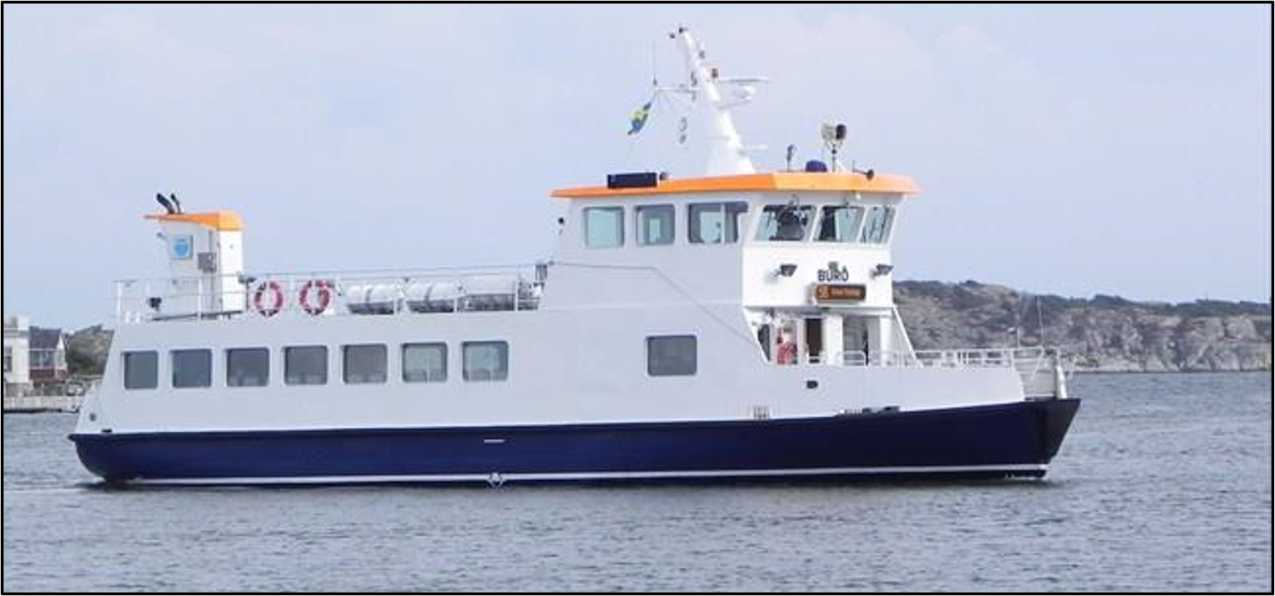
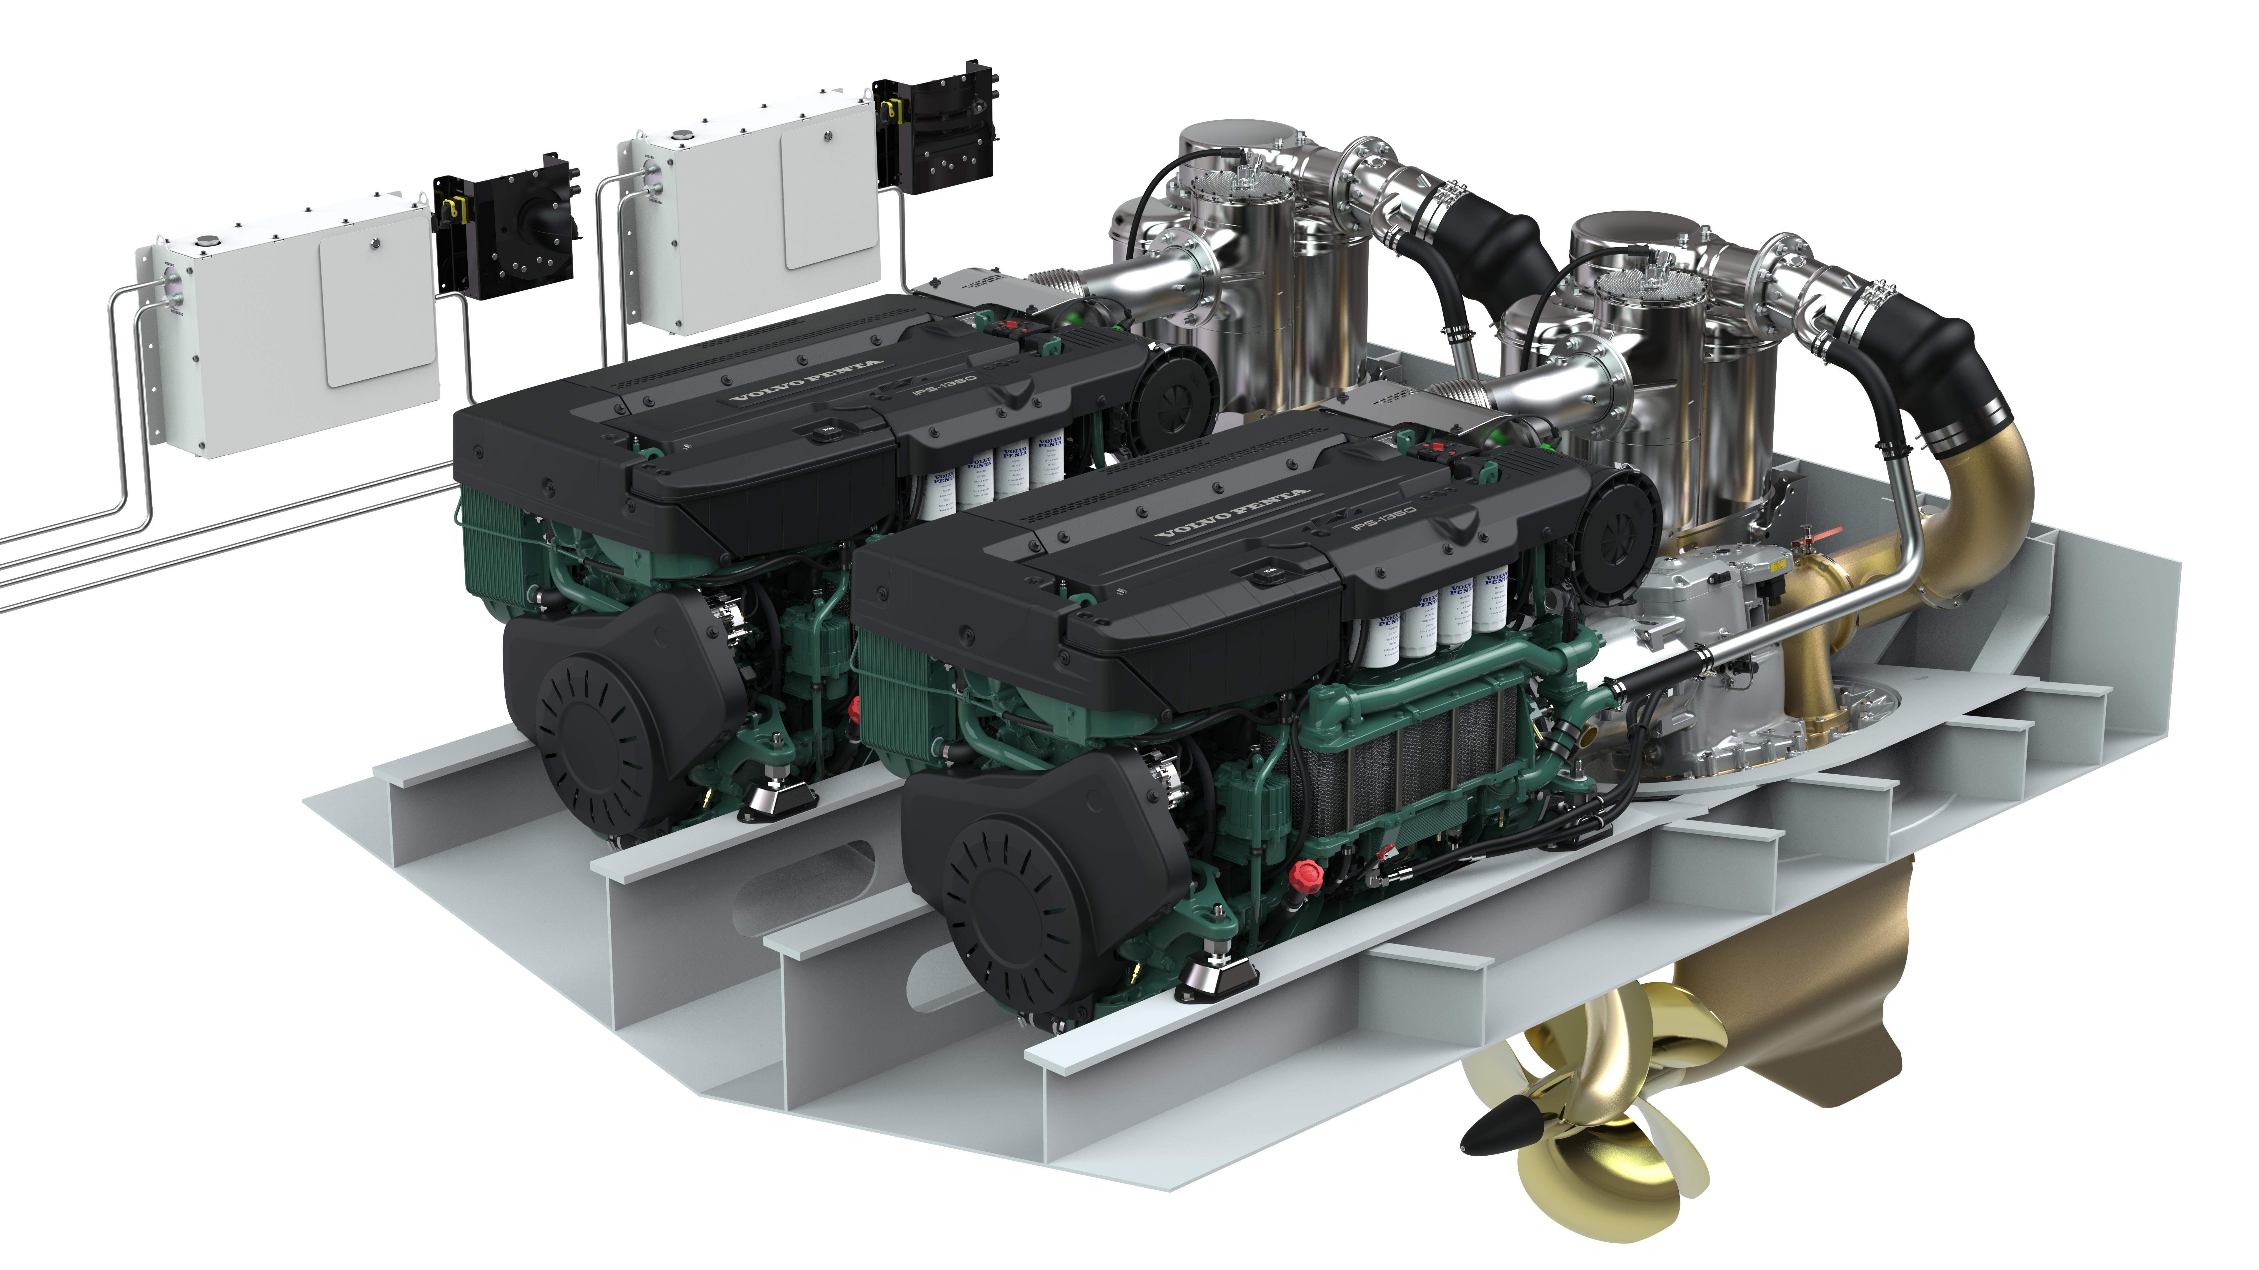
Descriptive Analytics
The ship’s onboard data have been received from our industry partner CetaSol AB in Gothenburg [1]. It has been gathered over the entire year of 2020. It has a 3Hz frequency and records about the ship's position, course direction, and speed. It is also including some of operational and meteorological data.
Ship name: Buro; Type: passenger ship,
Size:(Length by Breadth) 19m * 6.41m; Average speed is 8.2 knots(4.2 m/s)
Buro ferry Photo by Owe Johansson [2]
Engine Volvo Penta [3]
[1] CetaSol AB ." [Online]. Available: https://cetasol.com/
[2] https://www.marinetraffic.com/
[3] Engine Volvo Penta tier13 A2022 8398." [Online]. Available: https://www.volvopenta.com/about-us/news-page/2022/jun/imo-tier-iii-range-expands-with-new-d13-solutions/

Slide 5
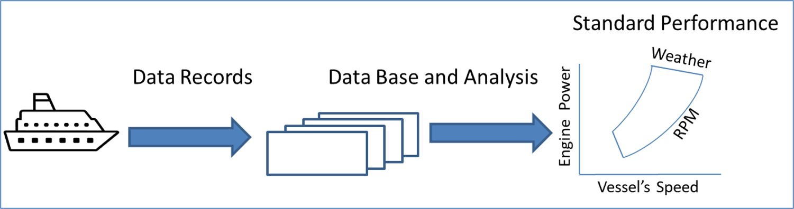
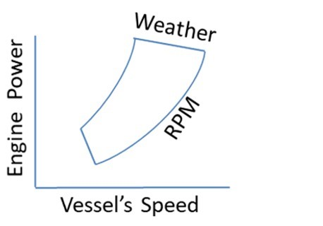
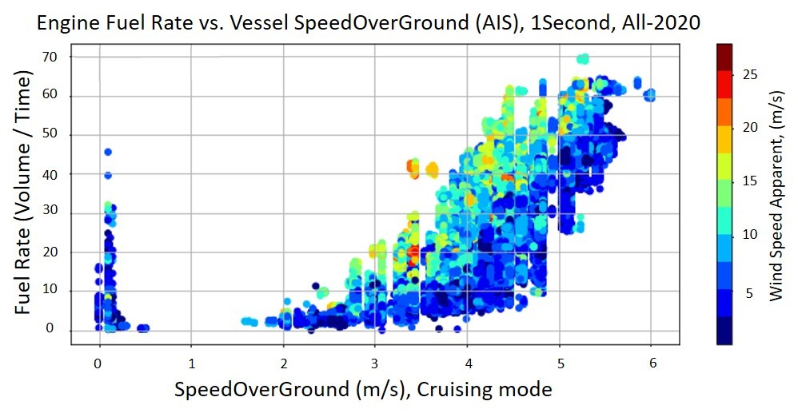
Descriptive Analytics
The vessel’s data analytics
(a) Ship standard performance [4].
(b) Vessel Buro’s Standard Performance Graph.
[4] J. Carlton, Marine propellers and propulsion. Butterworth-Heinemann, 2018.

Slide 6
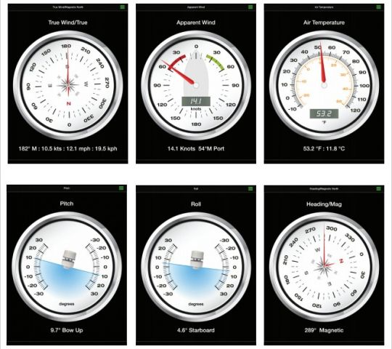
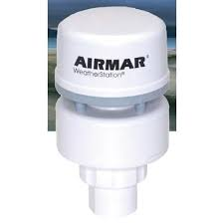
Descriptive Analytics
Some of Vessel’s Motion and Environmental Data are Collected from an Instrument installed on the Vessel.
[5] https://www.boatsnews.com/story/18720/the-weather-station-in-airmar-a-real-swiss-army-knife

Slide 7
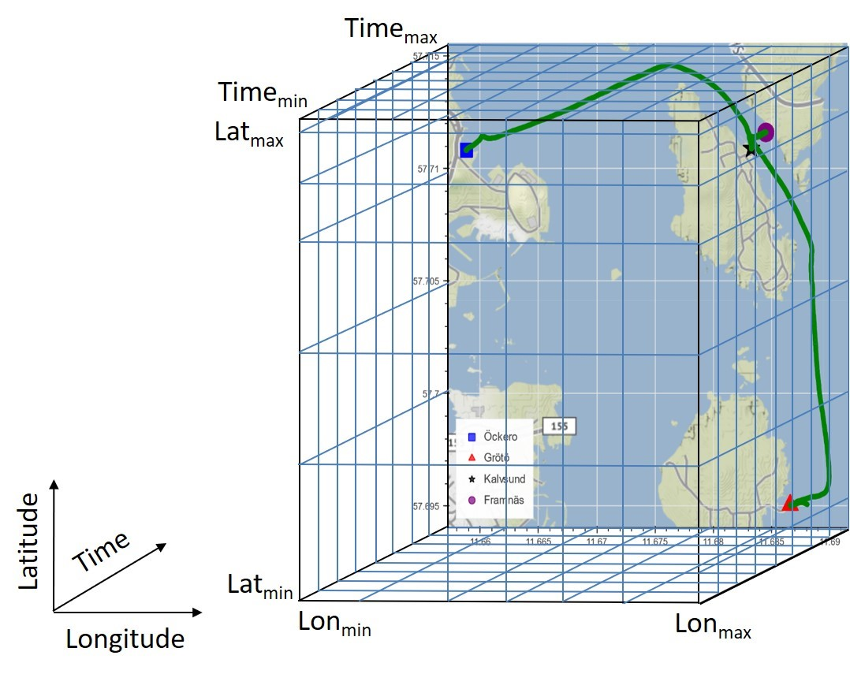
Descriptive Analytics
Trilinear Interpolation
A grid in which every point
has three attributes:
Time, Latitude, and Longitude.
Time: 2019-11-26 to 2022-04-23
Space:
Longitude=11.68 (nearest)
Latitude=57.71 (nearest)
Data: Averaged values of available features of Onboard and Weather data from External Sources. [6-7]
3-Dimension Linear Interpolation
[6] Copernicus Marine Service. [Online]. Available: https://marine.copernicus.eu/
[7] Stormglass API . [Online]. Available: https://stormglass.io/

Slide 8
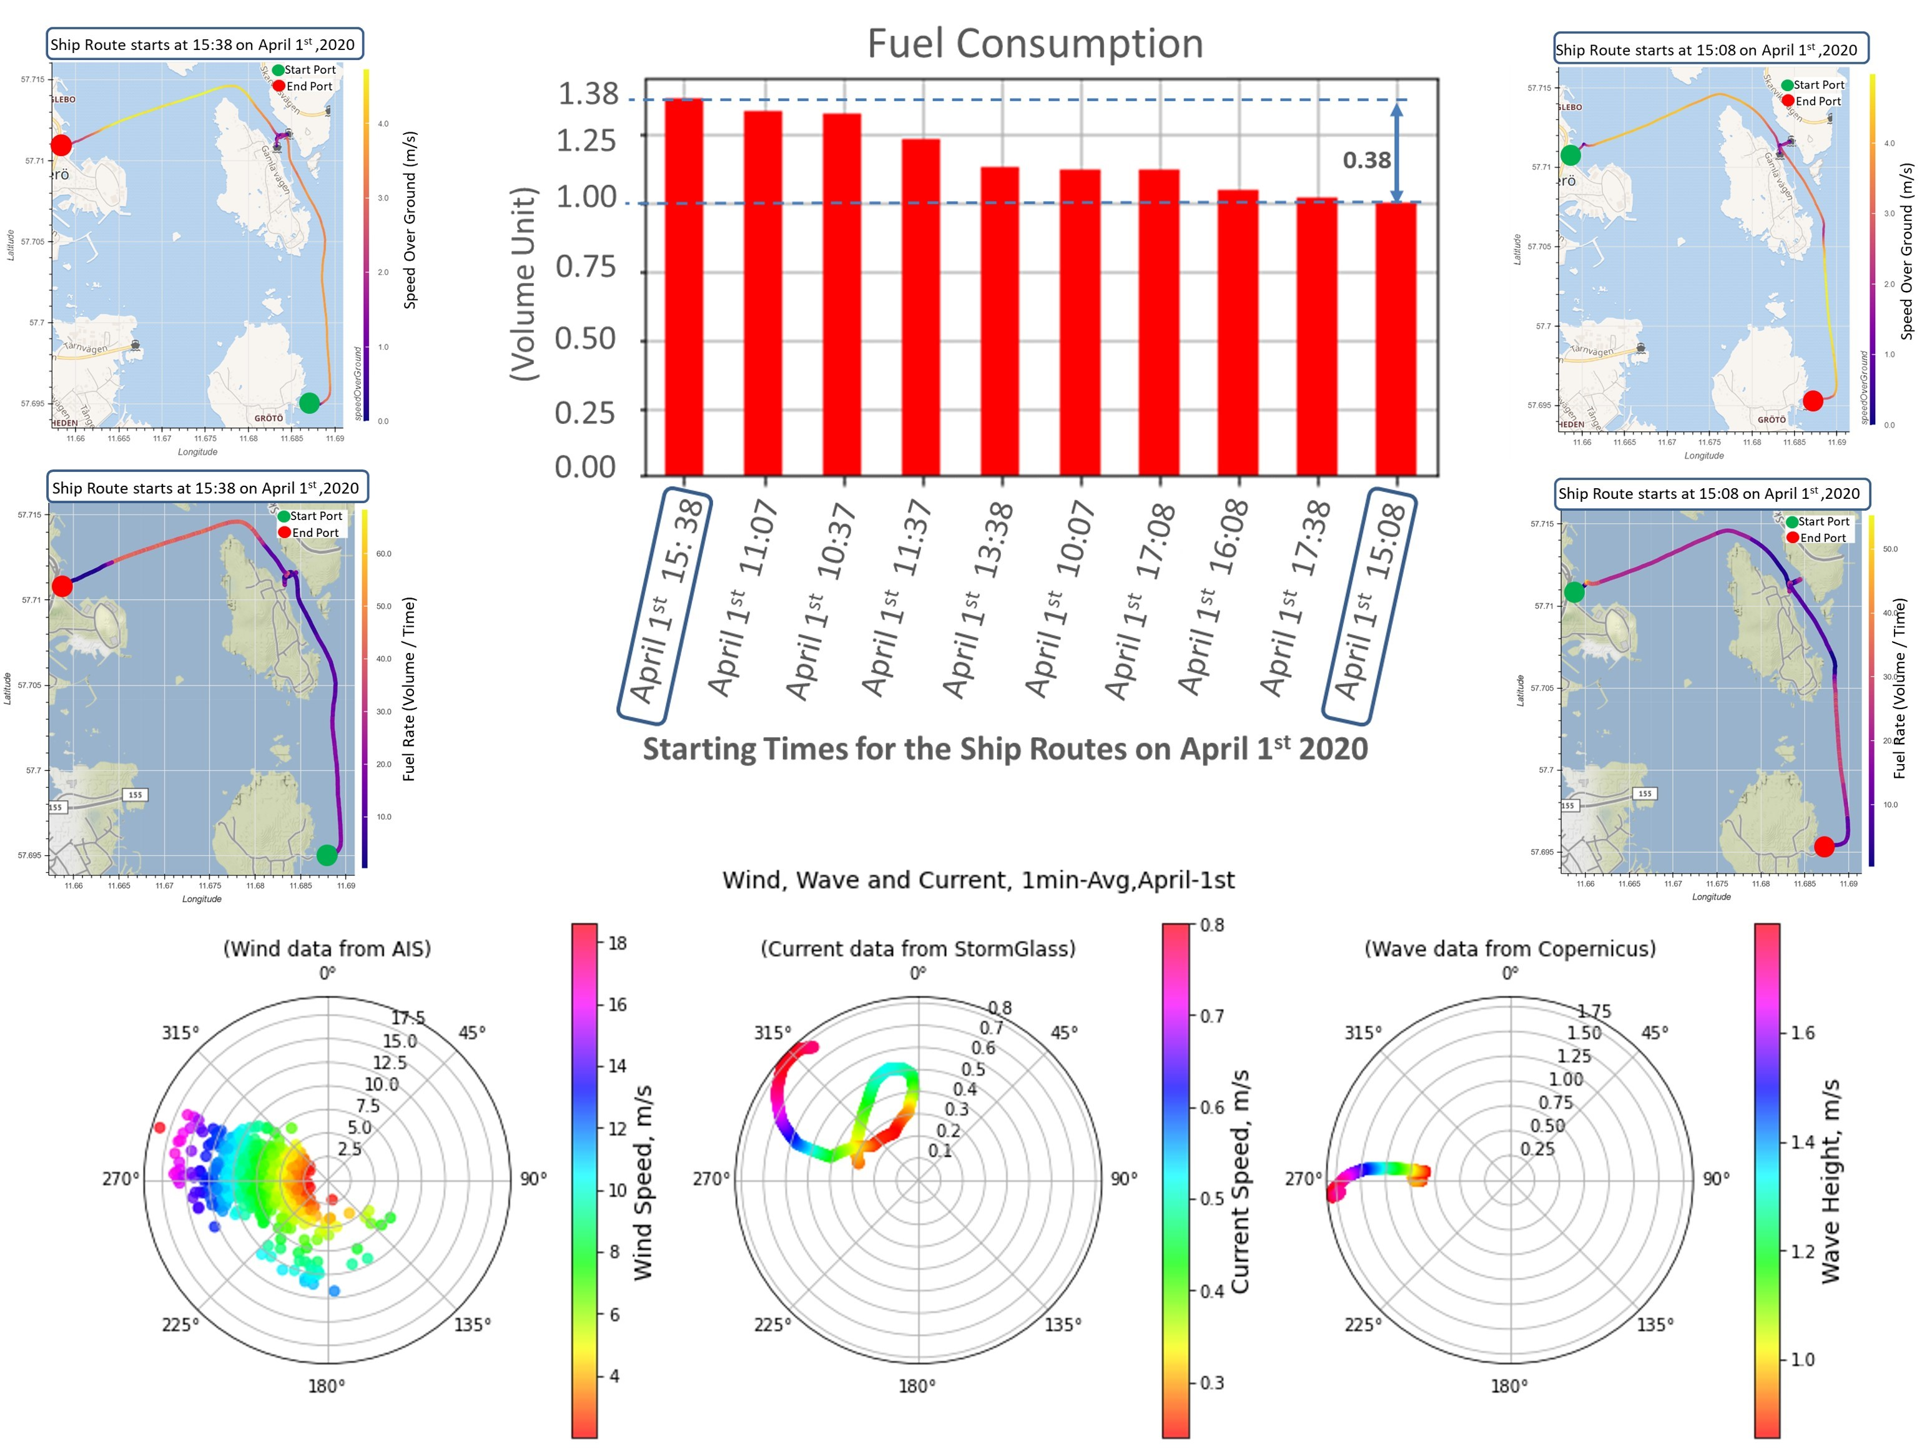
Descriptive Analytics
What are the main factors that impact the vessel’s fuel consumption for short-sea shipping?
The Vessel’s Operational and Environmental Data on April 1st, 2020

Slide 9
Descriptive Analytics
What are the main factors that impact the vessel’s fuel consumption for short-sea shipping?
Let’s consider an illustrative case of a passenger ship with actual profiles of fuel consumption as illustrated in figure 1. This ship has main routes between a port on the South side and a port on the North side, on April 1st, 2020.
By associating the weather and voyage factors with this illustrative case, as the ship started her route at 15 : 38 and then at the last part of the route it changed her course direction toward west which is against the wind, current and wave directions, i.e., 270o (degree). Nevertheless, it could be obvious that the weather has impacted the ship’s fuel consumption, the vessel’s speed was also increased simultaneously when the vessel headed westward. Thus, at this combination of weather conditions and speed, the vessel’s resistance has increased
and hence the fuel consumption became higher by about 38% more than just the previous route that started at 15 : 08.
Therefore, different factors of the voyage status and their combinations with the weather conditions should all be considered to perform a rational reasoning
for the vessel’s fuel consumption.

Slide 10
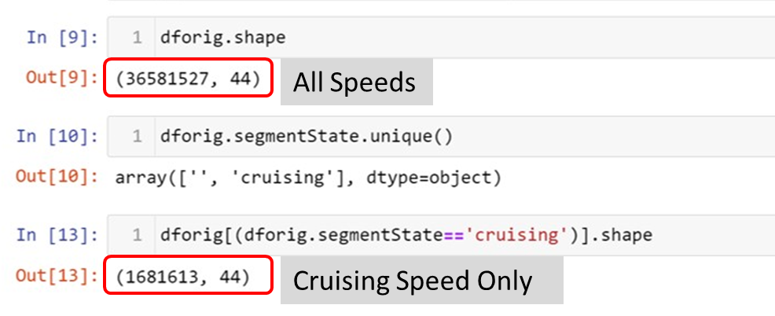
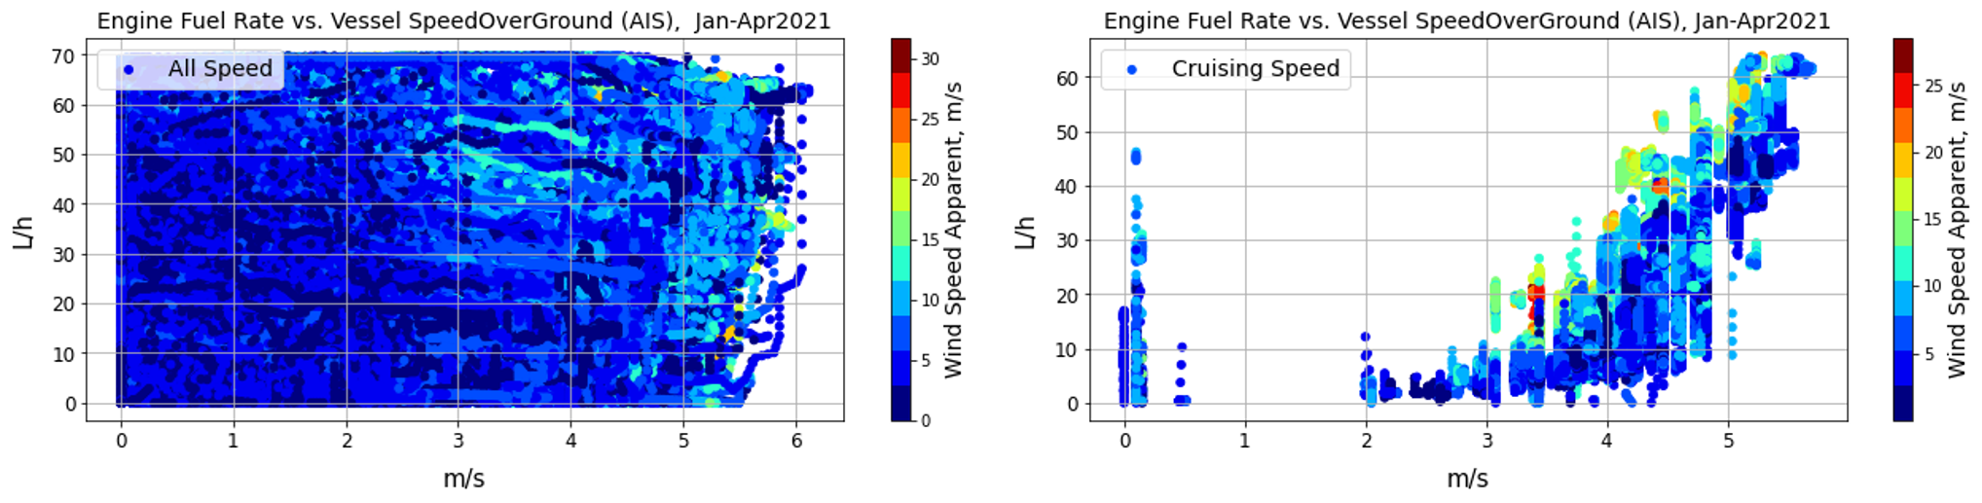
Descriptive Analytics
Cruising mode in Buro’s Data
➔ 1681613 out of 36581527
(i.e., 4.6% of data represent the cruising mode)

Slide 11
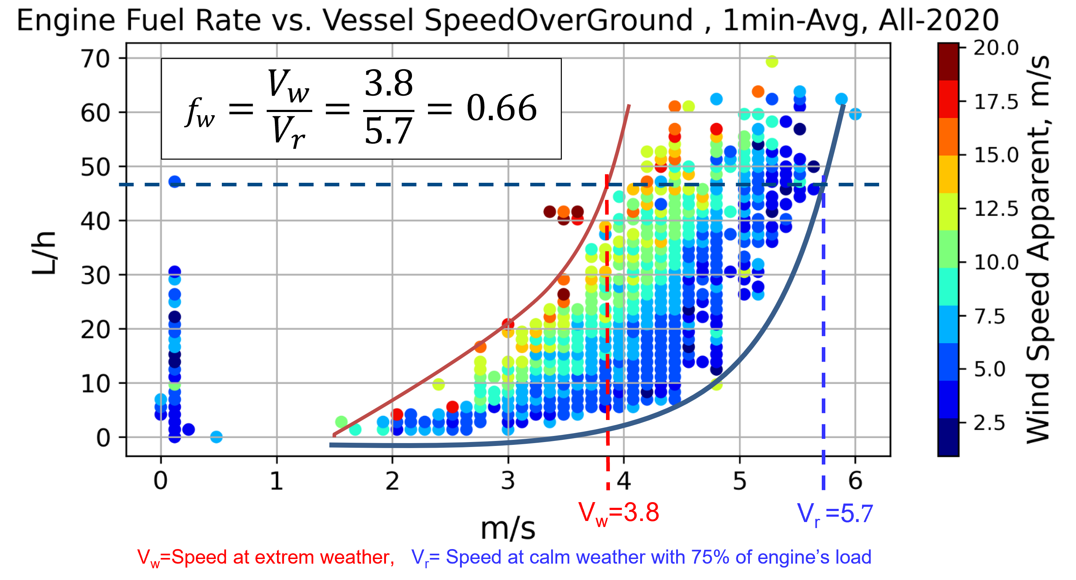
Descriptive Analytics
The weather factor obtained from the vessel’s standard performance graph
[8] Y. Kim, D. Hayden, D. Fathi, G. Hermanski, D. Hudson, P. d. Jong,K. Tanizawa, G. Thomas, and W. Chengshen, “Seakeeping committee final report and recommendations to the 27th ITTC," 2014.

Slide 12
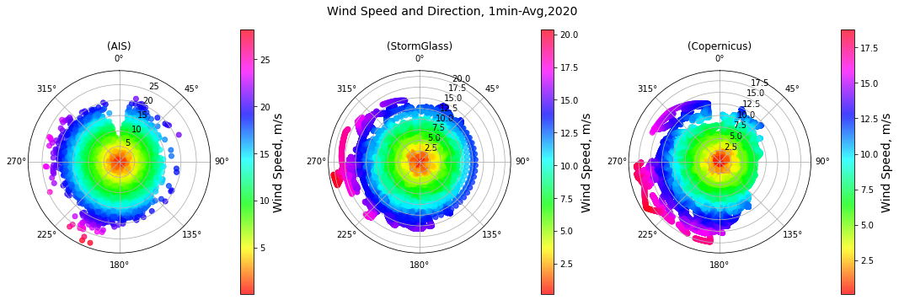
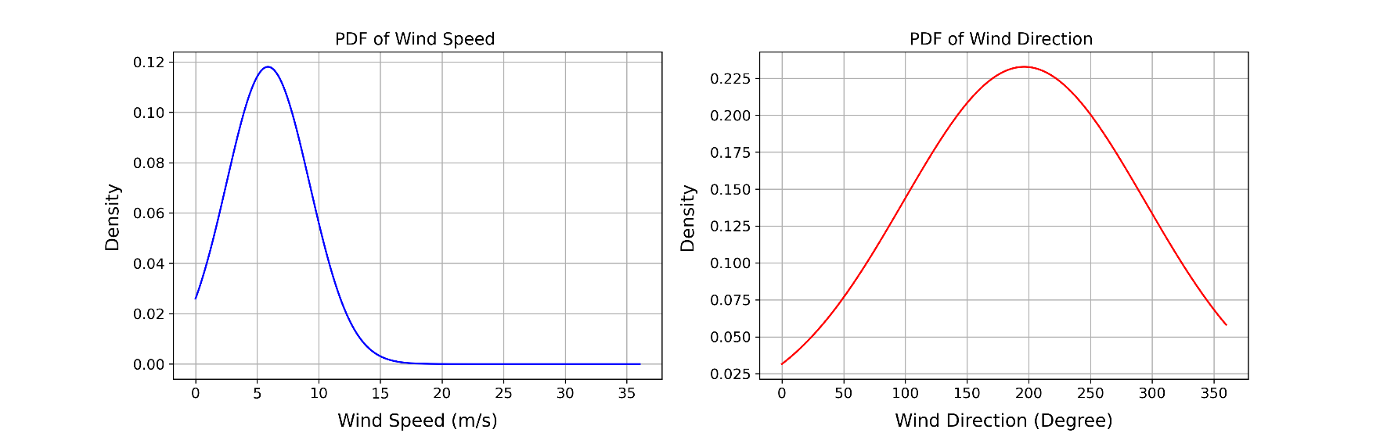
Descriptive Analytics
Wind from Different Sources in the Entire 2020
Probability Distribution of Wind Speed.

Slide 13
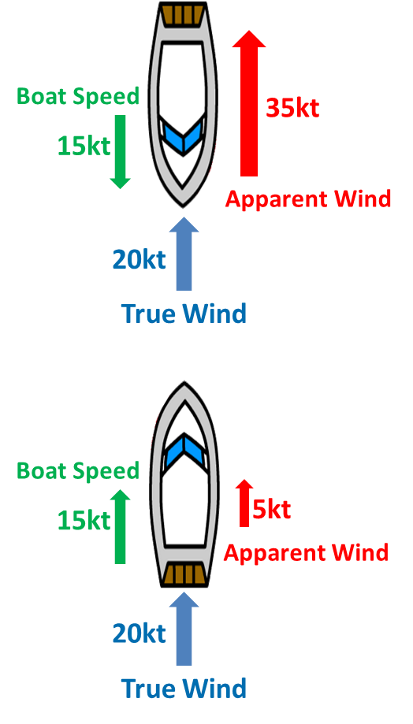
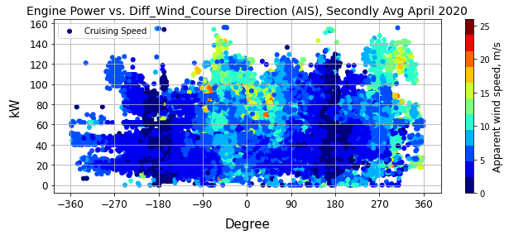
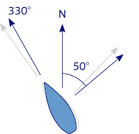
Descriptive Analytics
Spatial Analysis of the Vessel’s Routes and Fuel Consumption
Head Wind
Diff_Wind_Course = Wind Direction – Course Direction
Head winds are shown in the red oval shapes
Tail Wind
Drift angle (φ) = Course direction – Heading direction
Vessel’s Heading
Vessel’s Course
φ=80º
φ : Drift Angle [9]
[9] Tsujimoto, M., & Orihara, H. (2019). Performance prediction of full-scale ship and analysis by means of on-board monitoring (Part 1 ship performance prediction in actual seas). Journal of Marine Science and Technology, 24(1), 16-33.

Slide 14
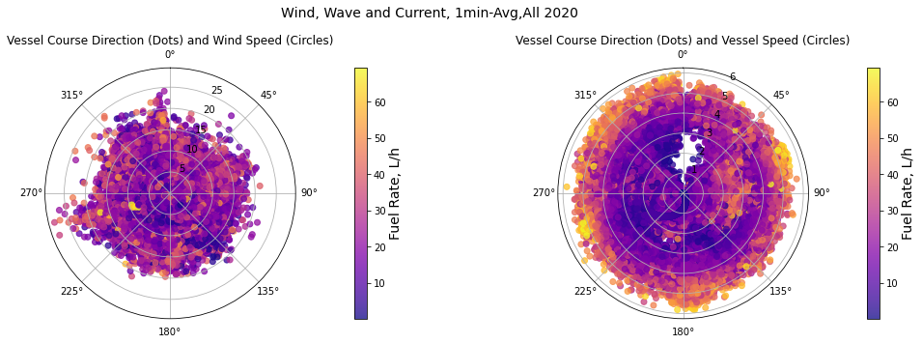
Descriptive Analytics
Spatial Analysis of the Vessel’s Routes and Fuel Consumption
Circles=Wind Speed
Circles=Vessel Speed
Polar graph for the Vessel’s Course with wind and vessel speed and fuel rate

Slide 15
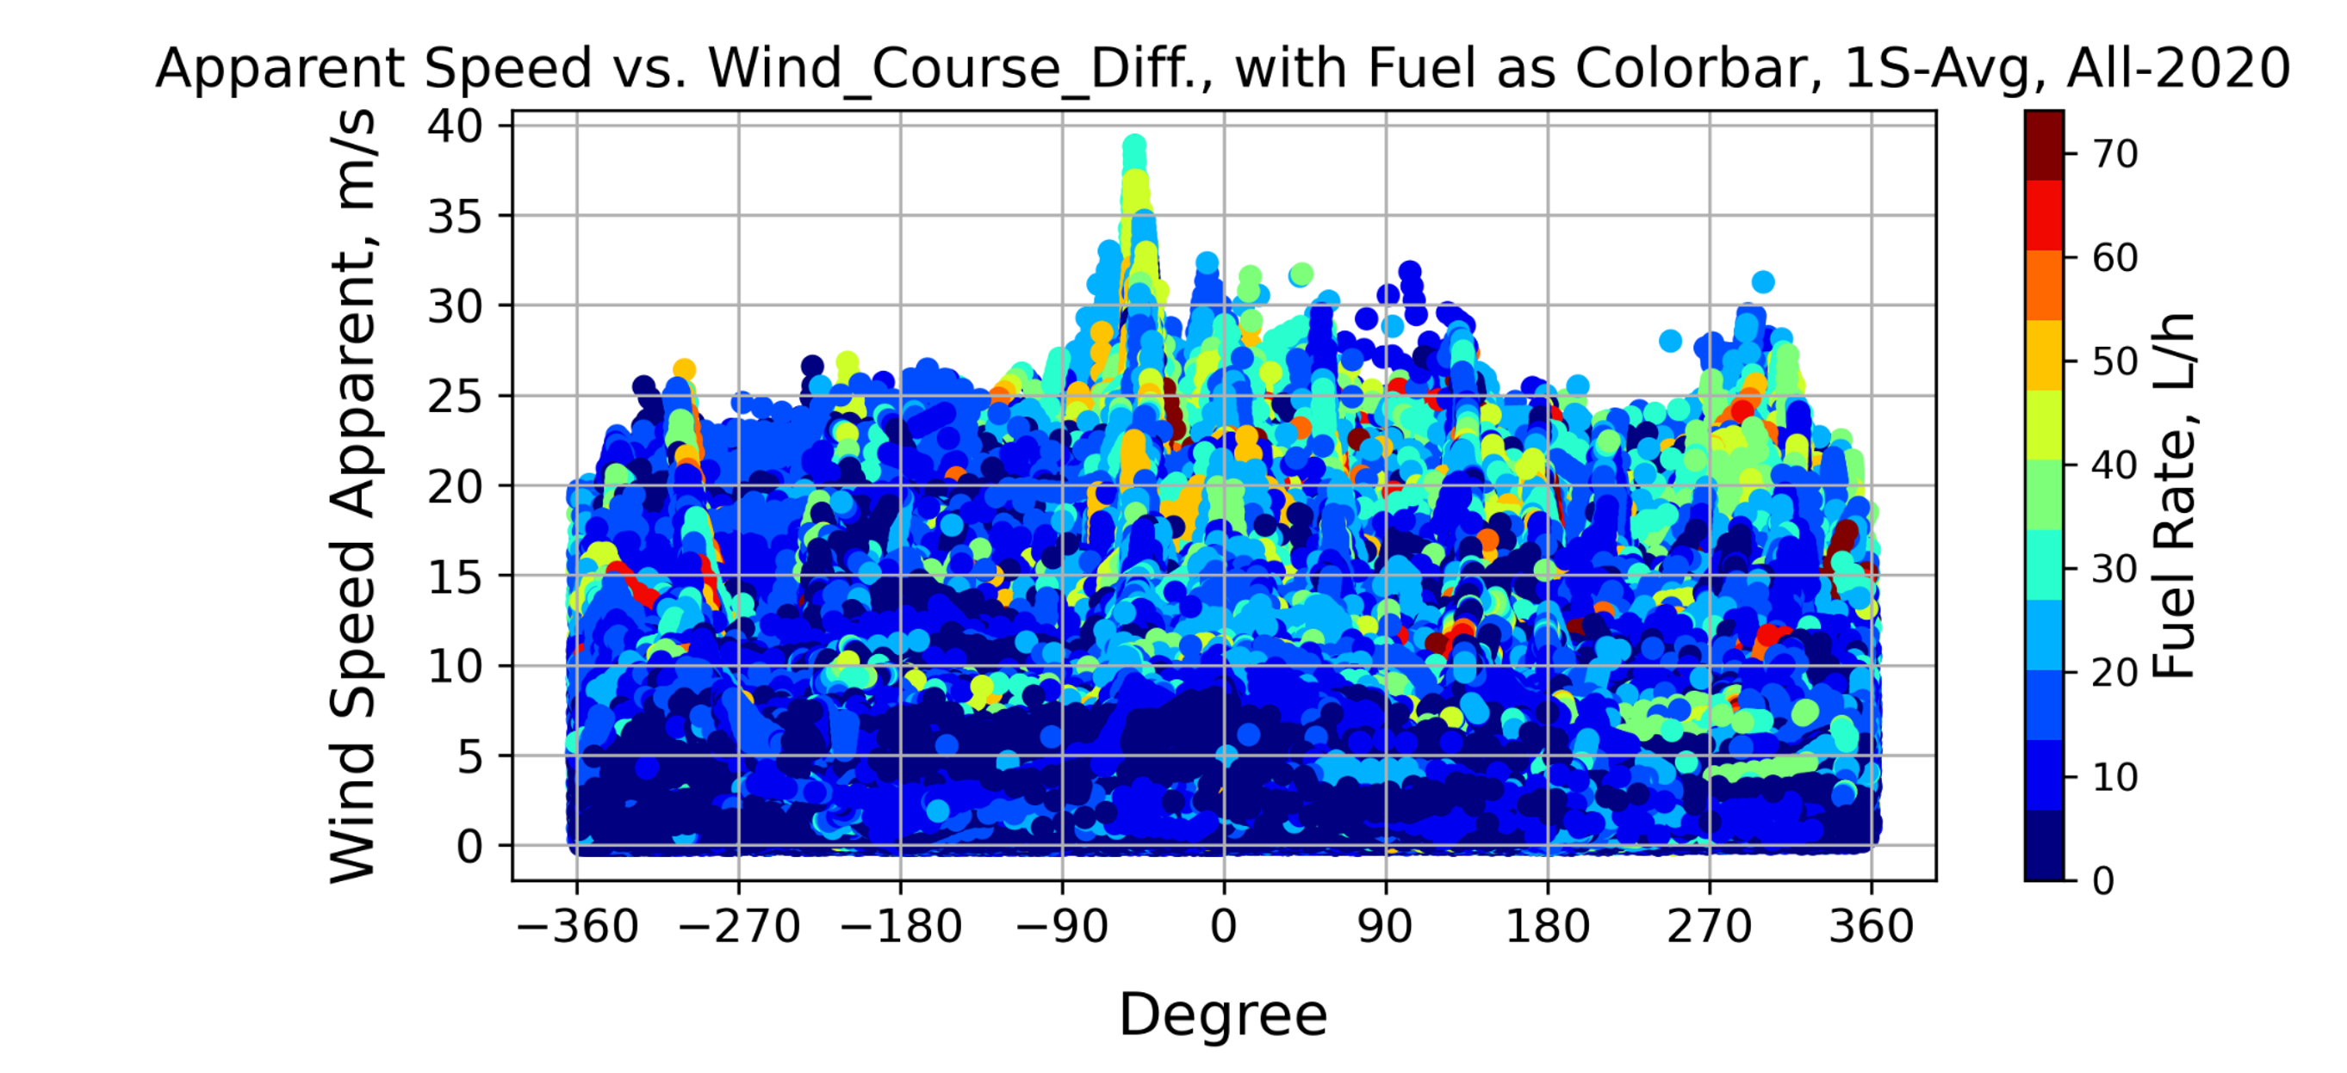
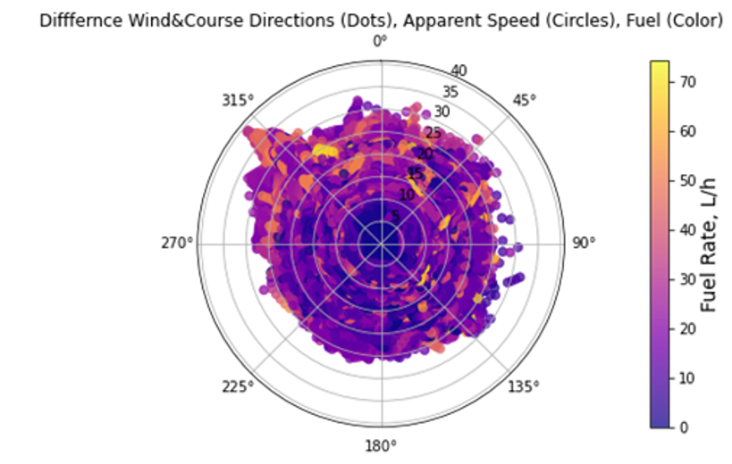
Descriptive Analytics
Spatial Analysis of the Vessel’s Routes and Fuel Consumption
(a) Color-bar Plot of the Speed Apparent vs. Differences
of Wind and Vessel’s Directions with Fuel Rate
(b) Polar Plot of Differences of Wind
and Vessel’s Directions with Fuel
Rate

Slide 16
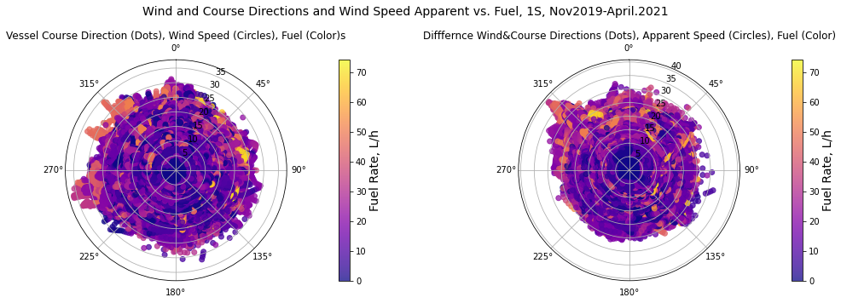
Descriptive Analytics
Spatial Analysis of the Vessel’s Routes and Fuel Consumption
Diff_WindCourse Intervals | count | fuel avg | sog avg | Sp_app avg | Diff_wncr avg | Wind_sp avg | Wind_dr avg | Course avg
(0, 90] | 8147300 | 15.42 | 2.21 | 7.40 | 45.06 | 5.76 | 219.91 | 174.86
(90, 180] | 7478087 | 15.23 | 2.27 | 4.99 | 131.87 | 5.66 | 253.69 | 121.83
(180, 270] | 2573125 | 16.70 | 1.75 | 4.86 | 218.78 | 5.57 | 286.16 | 67.38
(270, 360] | 940072 | 18.55 | 1.86 | 7.20 | 298.07 | 6.05 | 322.35 | 24.28
[0, -90) | 8452311 | 15.79 | 2.22 | 8.05 | -41.39 | 6.27 | 188.71 | 230.10
[-90, -180) | 4080962 | 13.65 | 1.78 | 5.03 | -135.41 | 5.45 | 130.83 | 266.23
[-180, -270) | 3430024 | 13.69 | 2.36 | 5.07 | -219.81 | 5.97 | 79.45 | 299.26
[-270, -360) | 1479646 | 15.22 | 2.58 | 8.35 | -300.98 | 6.74 | 35.80 | 336.78

Slide 17
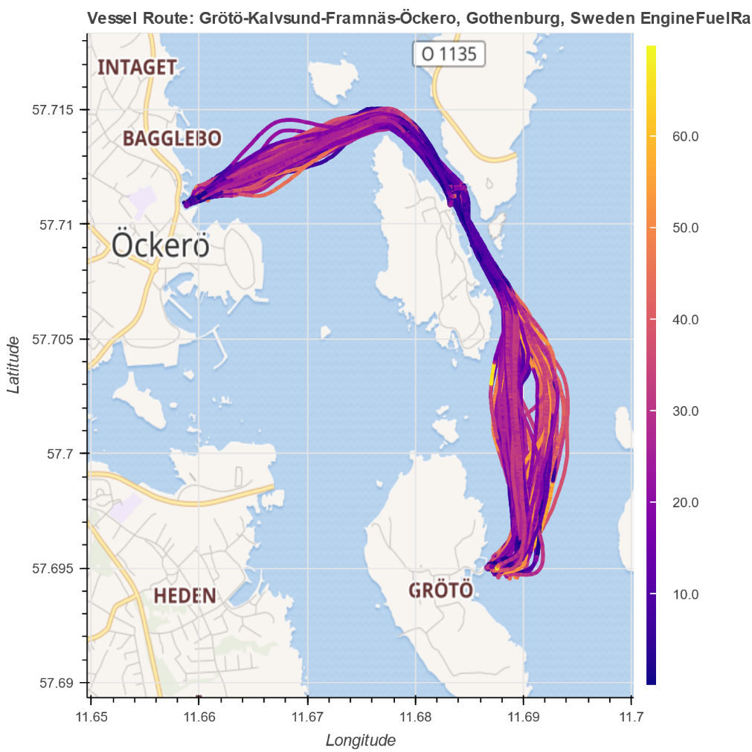
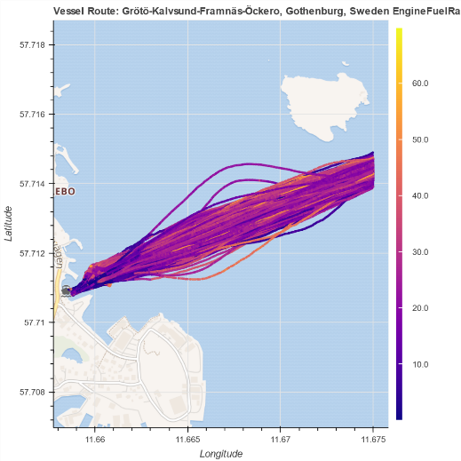
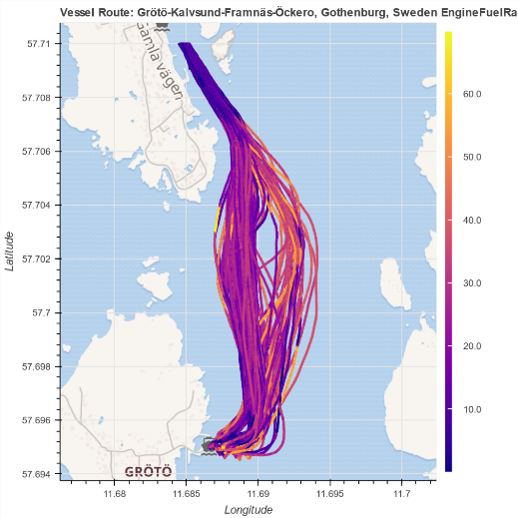
Descriptive Analytics
Spatial Analysis of the Vessel’s Routes and Fuel Consumption
Fuel Rate (L/H)
Northwest section of routes, March-April 2020
Southeast section of routes, March-April 2020

Slide 18
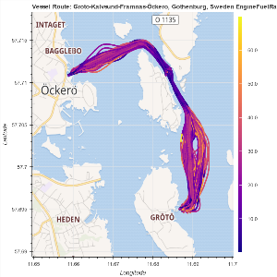
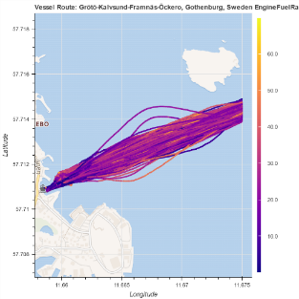
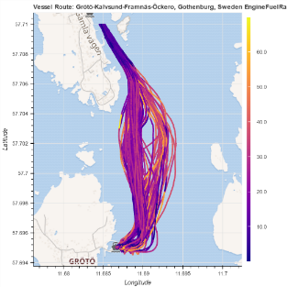
Descriptive Analytics
Spatial Analysis of the Vessel’s Routes and Fuel Consumption
Routes from South to North
Total Route
 | fuel | time | distance | SOG_avg | SpApp_avg | Diff_cswd_avg | Wind_sp_avg
Total Avg | 6.84 | 21.02 | 3.88 | 3.00 | 8.06 | 3.14 | 6.96
Top100 Avg | 5.56 | 20.29 | 3.80 | 3.06 | 7.58 | 27.16 | 6.60
Top50 Avg | 4.94 | 20.24 | 3.78 | 3.08 | 7.54 | 45.59 | 6.73
Bottom100 Avg | 8.24 | 21.60 | 3.97 | 2.97 | 8.52 | -24.38 | 7.30
Bottom50 Avg | 9.13 | 21.57 | 3.99 | 2.99 | 8.53 | -34.53 | 7.18
Northwest Segment
 | fuel | time | distance | SOG_avg | SpApp_avg | Diff_cswd_avg | Wind_sp_avg
Total Avg | 2.21 | 6.16 | 1.25 | 3.24 | 8.90 | -3.62 | 7.14
Top100 Avg | 1.78 | 5.93 | 1.22 | 3.24 | 8.88 | 19.69 | 7.21
Top50 Avg | 1.56 | 6.02 | 1.21 | 3.21 | 8.97 | 32.41 | 7.38
Bottom100 Avg | 2.68 | 6.38 | 1.29 | 3.27 | 8.85 | -28.61 | 6.94
Bottom50 Avg | 2.96 | 6.41 | 1.31 | 3.32 | 8.37 | -37.35 | 6.41
Southeast Segment
 | fuel | time | distance | SOG_avg | SpApp_avg | Diff_cswd_avg | Wind_sp_avg
Total Avg | 2.18 | 5.59 | 1.27 | 3.99 | 8.60 | -33.91 | 7.92
Top100 Avg | 1.70 | 5.51 | 1.25 | 3.98 | 7.73 | -3.49 | 7.16
Top50 Avg | 1.48 | 5.53 | 1.25 | 3.95 | 7.57 | 20.45 | 7.32
Bottom100 Avg | 2.71 | 5.66 | 1.29 | 4.00 | 9.40 | -67.44 | 8.66
Bottom50 Avg | 3.05 | 5.53 | 1.28 | 4.09 | 9.59 | -76.35 | 8.60

Slide 19
Descriptive Analytics
Spatial Analysis of the Vessel’s Routes and Fuel Consumption
Routes from North to South
Total Route
 | fuel | time | distance | SOG_avg | SpApp_avg | Diff_cswd_avg | Wind_sp_avg
Total Avg | 6.00 | 20.30 | 3.77 | 3.11 | 6.63 | -63.30 | 6.03
Top100 Avg | 4.75 | 19.87 | 3.74 | 3.16 | 5.72 | -67.48 | 5.37
Top50 Avg | 4.28 | 19.59 | 3.73 | 3.21 | 5.36 | -78.94 | 5.12
Bottom100 Avg | 7.24 | 20.78 | 3.80 | 3.05 | 7.58 | -60.54 | 6.81
Bottom50 Avg | 7.90 | 20.94 | 3.80 | 3.05 | 8.32 | -50.38 | 7.30
Northwest Segment
 | fuel | time | distance | SOG_avg | SpApp_avg | Diff_cswd_avg | Wind_sp_avg
Total Avg | 1.88 | 5.09 | 1.21 | 4.12 | 5.64 | -128.15 | 6.21
Top100 Avg | 1.54 | 5.13 | 1.19 | 4.01 | 5.89 | -119.84 | 6.03
Top50 Avg | 1.42 | 5.23 | 1.19 | 3.95 | 5.81 | -120.72 | 5.81
Bottom100 Avg | 2.18 | 5.03 | 1.22 | 4.22 | 5.36 | -138.44 | 6.43
Bottom50 Avg | 2.32 | 4.95 | 1.22 | 4.29 | 5.54 | -130.08 | 6.36
Southeast Segment
 | fuel | time | distance | SOG_avg | SpApp_avg | Diff_cswd_avg | Wind_sp_avg
Total Avg | 1.69 | 5.96 | 1.19 | 3.64 | 8.40 | -25.93 | 6.85
Top100 Avg | 1.19 | 5.81 | 1.18 | 3.68 | 6.51 | -32.10 | 5.61
Top50 Avg | 1.07 | 5.71 | 1.19 | 3.74 | 5.77 | -46.78 | 5.05
Bottom100 Avg | 2.21 | 6.12 | 1.18 | 3.60 | 10.38 | -20.89 | 8.25
Bottom50 Avg | 2.49 | 6.24 | 1.17 | 3.53 | 11.49 | -9.53 | 9.17

Slide 20
Descriptive Analytics
Correlation of Engine’s Fuel Rate with Weather factors
Correlation 1 Min | Speed_sog_ais | wind_sog_ais | wind_ cds | wind_ sg | wind_dr_sog_ais | wind_dr_cds | wind_dr_sg_ais | wind_app_ais | wind_app_cds | wind_app_sg | current_ sp_sg | current_ Dr_sg | wave_ht_cds | wave_dr_cds | wavedrg_cff_cds | roll_ ais | pitch_ ais | engine_fuelrate_ais
Speed_sog_ Ais | 1.0000 | 0.1780 | 0.0175 | -0.0099 | -0.0200 | 0.1071 | 0.0902 | 0.6076 | 0.0859 | 0.0575 | -0.0632 | 0.0024 | 0.0134 | 0.1060 | 0.0134 | 0.0129 | 0.4497 | 0.4986
wind_sog_ais | 0.1780 | 1.0000 | 0.6009 | 0.5602 | 0.0518 | 0.0495 | 0.0556 | 0.8897 | 0.5537 | 0.5364 | 0.2956 | 0.1175 | 0.6021 | -0.0379 | 0.5905 | 0.0869 | 0.2051 | 0.2468
wind_cds | 0.0175 | 0.6009 | 1.0000 | 0.8699 | 0.1349 | 0.1686 | 0.1776 | 0.4858 | 0.9566 | 0.8432 | 0.4392 | 0.2979 | 0.9627 | 0.0550 | 0.9599 | 0.0349 | 0.0857 | 0.1064
wind_sg | -0.0099 | 0.5602 | 0.8699 | 1.0000 | 0.1359 | 0.1119 | 0.1322 | 0.4513 | 0.8283 | 0.9595 | 0.4683 | 0.2423 | 0.8690 | 0.0371 | 0.8588 | 0.0491 | 0.0584 | 0.1100
wind_dr_sog_ais | -0.0200 | 0.0518 | 0.1349 | 0.1359 | 1.0000 | 0.6837 | 0.5944 | 0.0326 | 0.1212 | 0.1196 | -0.0616 | 0.2091 | 0.1581 | 0.6151 | 0.1274 | 0.0145 | -0.0182 | 0.0051
wind_dr_cds | 0.1071 | 0.0495 | 0.1686 | 0.1119 | 0.6837 | 1.0000 | 0.7230 | 0.0459 | 0.1675 | 0.1088 | -0.0163 | 0.3189 | 0.1949 | 0.6905 | 0.1624 | 0.0224 | 0.0072 | 0.0454
wind_dr_sg | 0.0902 | 0.0556 | 0.1776 | 0.1322 | 0.5944 | 0.7230 | 1.0000 | 0.0498 | 0.1724 | 0.1228 | 0.0114 | 0.3050 | 0.1946 | 0.6109 | 0.1677 | 0.0235 | 0.0063 | 0.0300
wind_app_ ais | 0.6076 | 0.8897 | 0.4858 | 0.4513 | 0.0326 | 0.0459 | 0.0498 | 1.0000 | 0.4898 | 0.4727 | 0.2320 | 0.0963 | 0.4856 | -0.0250 | 0.4773 | 0.0761 | 0.3742 | 0.4306
wind_app_ cds | 0.0859 | 0.5537 | 0.9566 | 0.8283 | 0.1212 | 0.1675 | 0.1724 | 0.4898 | 1.0000 | 0.8759 | 0.4131 | 0.2938 | 0.9206 | 0.0512 | 0.9177 | 0.0660 | 0.1294 | 0.1542
wind_app_sg | 0.0575 | 0.5364 | 0.8432 | 0.9595 | 0.1196 | 0.1088 | 0.1228 | 0.4727 | 0.8759 | 1.0000 | 0.4451 | 0.2377 | 0.8409 | 0.0299 | 0.8306 | 0.0787 | 0.1060 | 0.1545
current_sp_ sg | -0.0632 | 0.2956 | 0.4392 | 0.4683 | -0.0616 | -0.0163 | 0.0114 | 0.2320 | 0.4131 | 0.4451 | 1.0000 | 0.1660 | 0.4584 | -0.0799 | 0.4453 | 0.0090 | 0.0177 | 0.0475
current_dr_ sg | 0.0024 | 0.1175 | 0.2979 | 0.2423 | 0.2091 | 0.3189 | 0.3050 | 0.0963 | 0.2938 | 0.2377 | 0.1660 | 1.0000 | 0.3072 | 0.2364 | 0.2813 | 0.0119 | 0.0001 | 0.0443
wave_ht_cds | 0.0134 | 0.6021 | 0.9627 | 0.8690 | 0.1581 | 0.1949 | 0.1946 | 0.4856 | 0.9206 | 0.8409 | 0.4584 | 0.3072 | 1.0000 | 0.0822 | 0.9642 | 0.0213 | 0.0780 | 0.1062
wave_dr_cds | 0.1060 | -0.0379 | 0.0550 | 0.0371 | 0.6151 | 0.6905 | 0.6109 | -0.0250 | 0.0512 | 0.0299 | -0.0799 | 0.2364 | 0.0822 | 1.0000 | 0.0604 | 0.0317 | -0.0122 | 0.0167
wavedrg_cff_cds | 0.0134 | 0.5905 | 0.9599 | 0.8588 | 0.1274 | 0.1624 | 0.1677 | 0.4773 | 0.9177 | 0.8306 | 0.4453 | 0.2813 | 0.9642 | 0.0604 | 1.0000 | 0.0265 | 0.0771 | 0.1097
roll_ais | 0.0129 | 0.0869 | 0.0349 | 0.0491 | 0.0145 | 0.0224 | 0.0235 | 0.0761 | 0.0660 | 0.0787 | 0.0090 | 0.0119 | 0.0213 | 0.0317 | 0.0265 | 1.0000 | -0.0690 | 0.0839
pitch_ais | 0.4497 | 0.2051 | 0.0857 | 0.0584 | -0.0182 | 0.0072 | 0.0063 | 0.3742 | 0.1294 | 0.1060 | 0.0177 | 0.0001 | 0.0780 | -0.0122 | 0.0771 | -0.0690 | 1.0000 | 0.6003
engine_fuelrate_ais | 0.4986 | 0.2468 | 0.1064 | 0.1100 | 0.0051 | 0.0454 | 0.0300 | 0.4306 | 0.1542 | 0.1545 | 0.0475 | 0.0443 | 0.1062 | 0.0167 | 0.1097 | 0.0839 | 0.6003 | 1.0000
*(AIS): Onboard Data, (CDS): Copernicus Weather data, (SG): Storm Glass Weather Data
All 2020
1-Minute
All Speeds

Slide 21
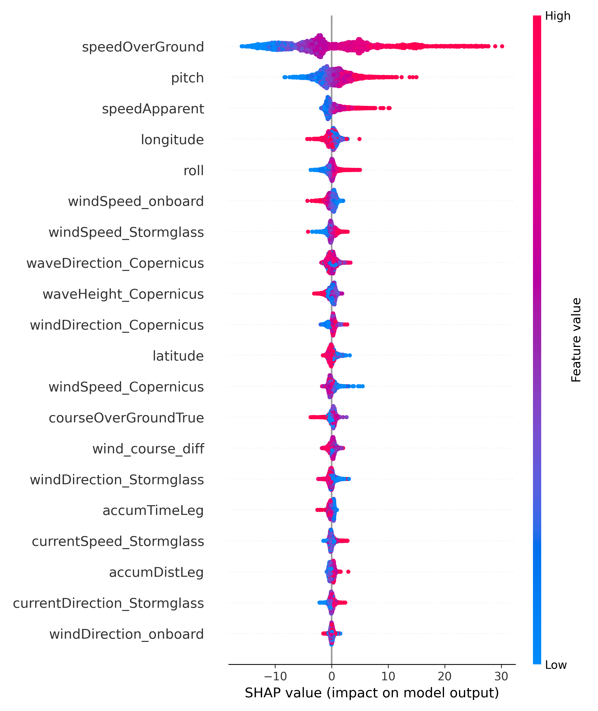
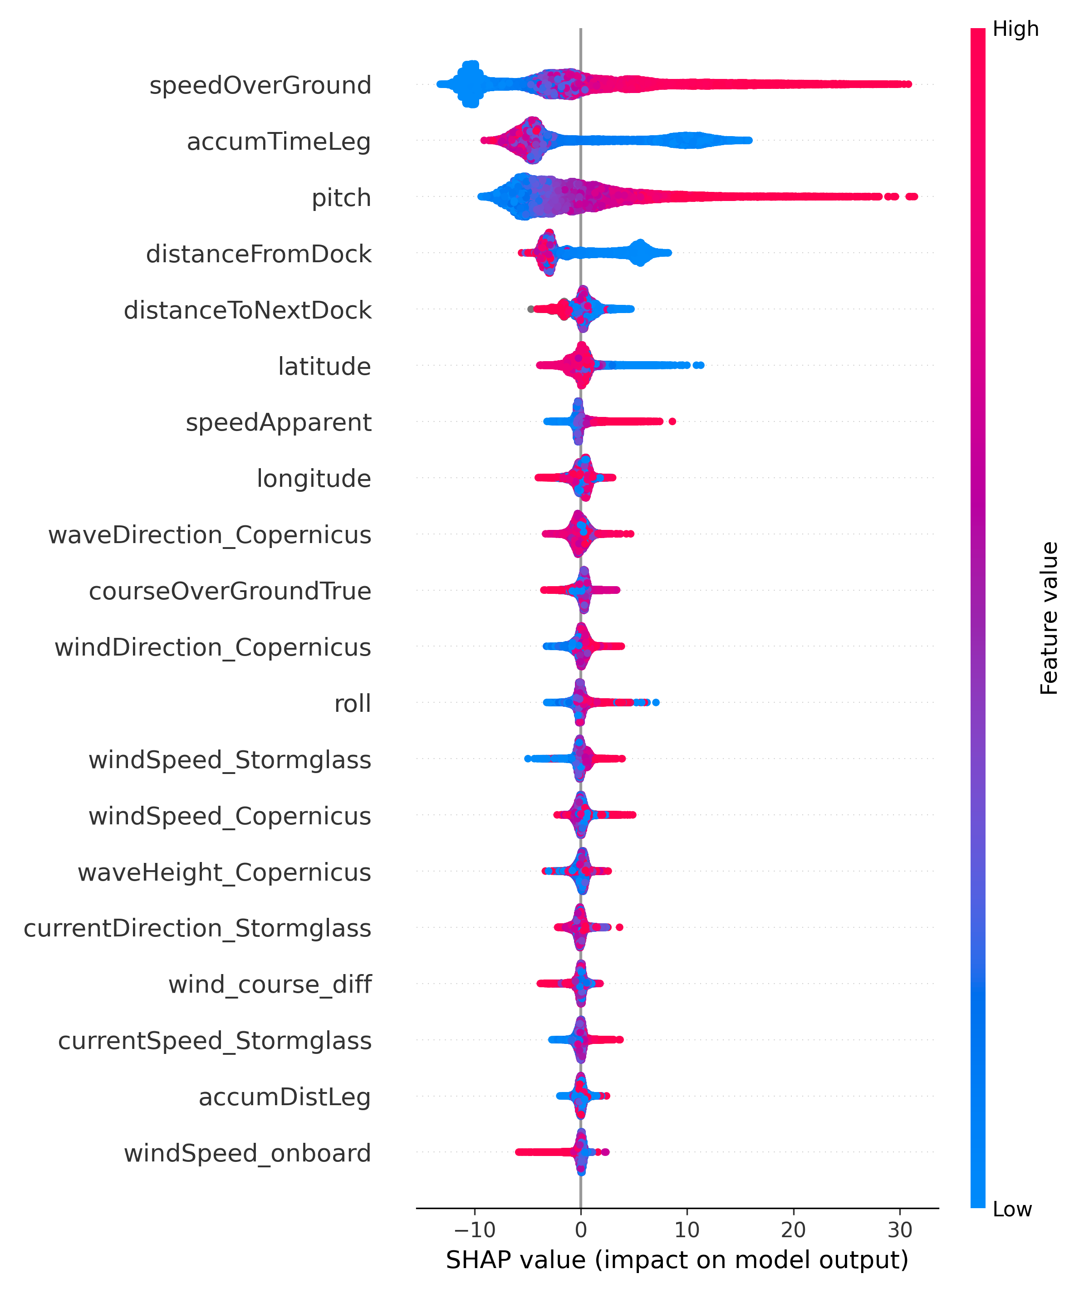
Predictive Analytics
(a) Shapley values for the available features
(b) Shapley values for the available features with cruising-mode speeds with all speeds
[10] S. M. Lundberg and S.-I. Lee, “A unified approach to interpreting model predictions," Advances in neural information
processing systems, vol. 30,2017.

Slide 22
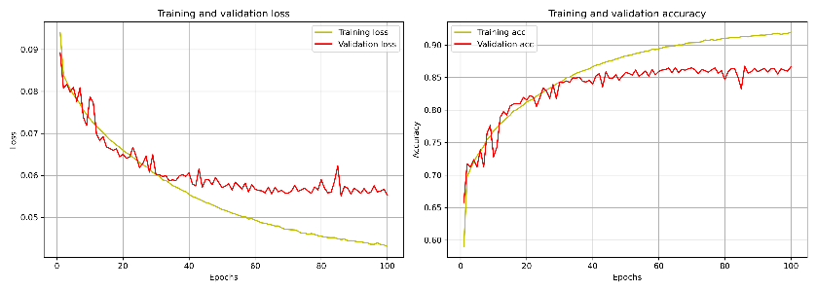
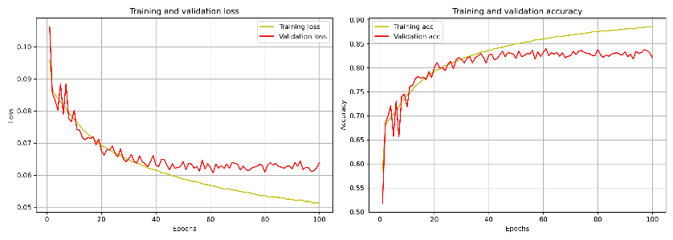
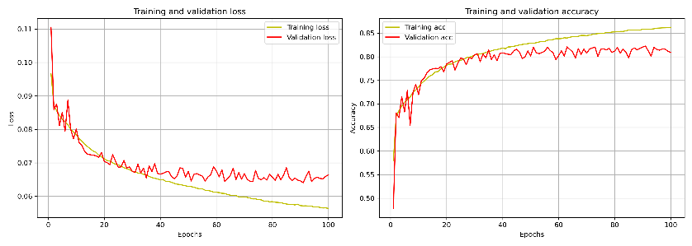
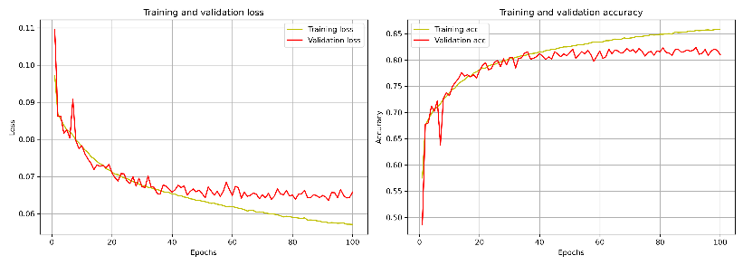
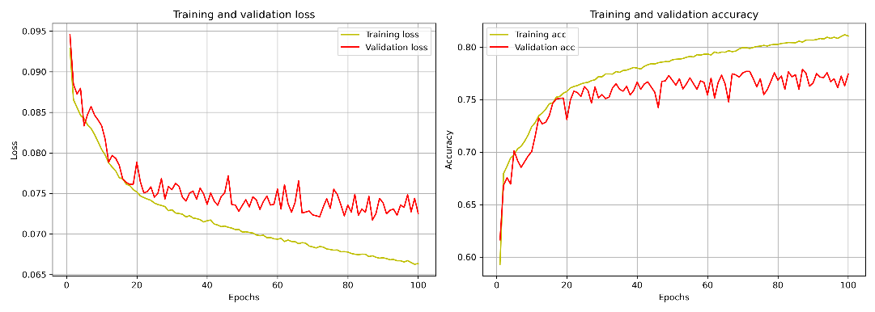
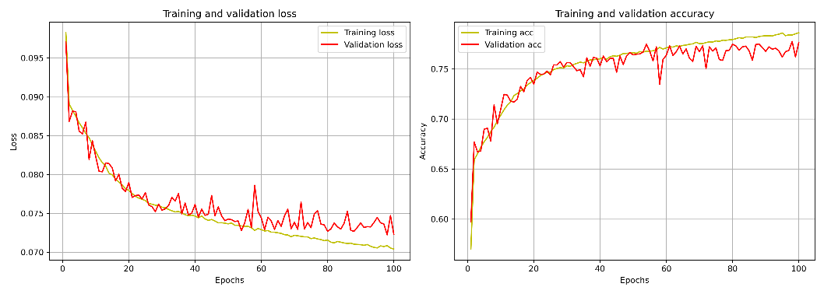
Predictive Analytics
All Speeds
All Variable, 22inputs
Plots of ANN Training and searching optimal ANN’s parameters and inputs
11inputs Wind from Onboard
11inputs Wind from Copernicus
11inputs Wind from Sormglass
Without Wind-related or any weather-related variables
AllVars, Excluding weather related variables, 10inputs
11inputs, Excluding wind-related variables, 7inputs

Slide 23
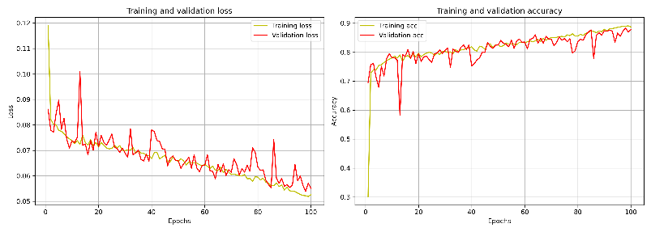
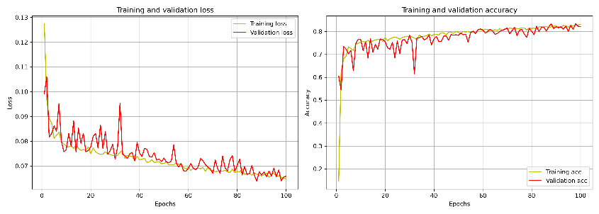
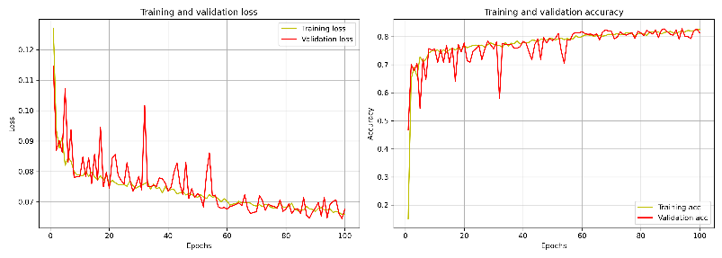
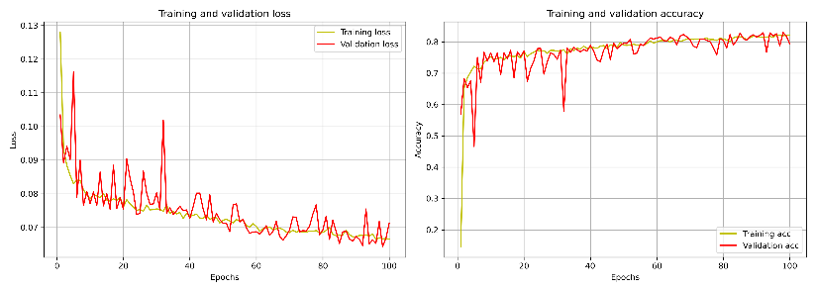
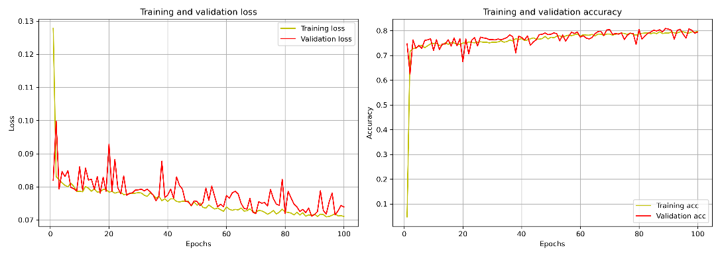
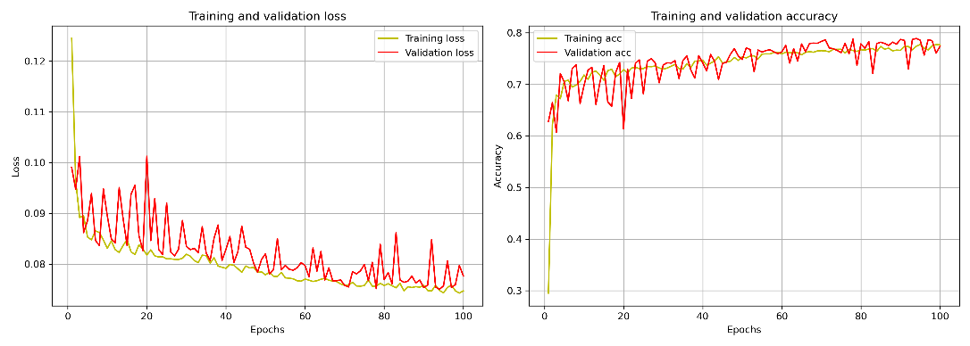
Predictive Analytics
Cruising Speed Only ➔(i.e., 4.6% of All-Speeds data are used for these results)
AllVars, 22inputs
Plots of ANN Training and searching optimal ANN’s parameters and inputs
11inputs Wind from Onboard
11inputs Wind from Copernicus
11inputs Wind from Sormglass
Without Wind-related or any weather-related variables
AllVars, Excluding weather related variables, 10inputs
11inputs, Excluding wind-related variables, 7inputs

Slide 24
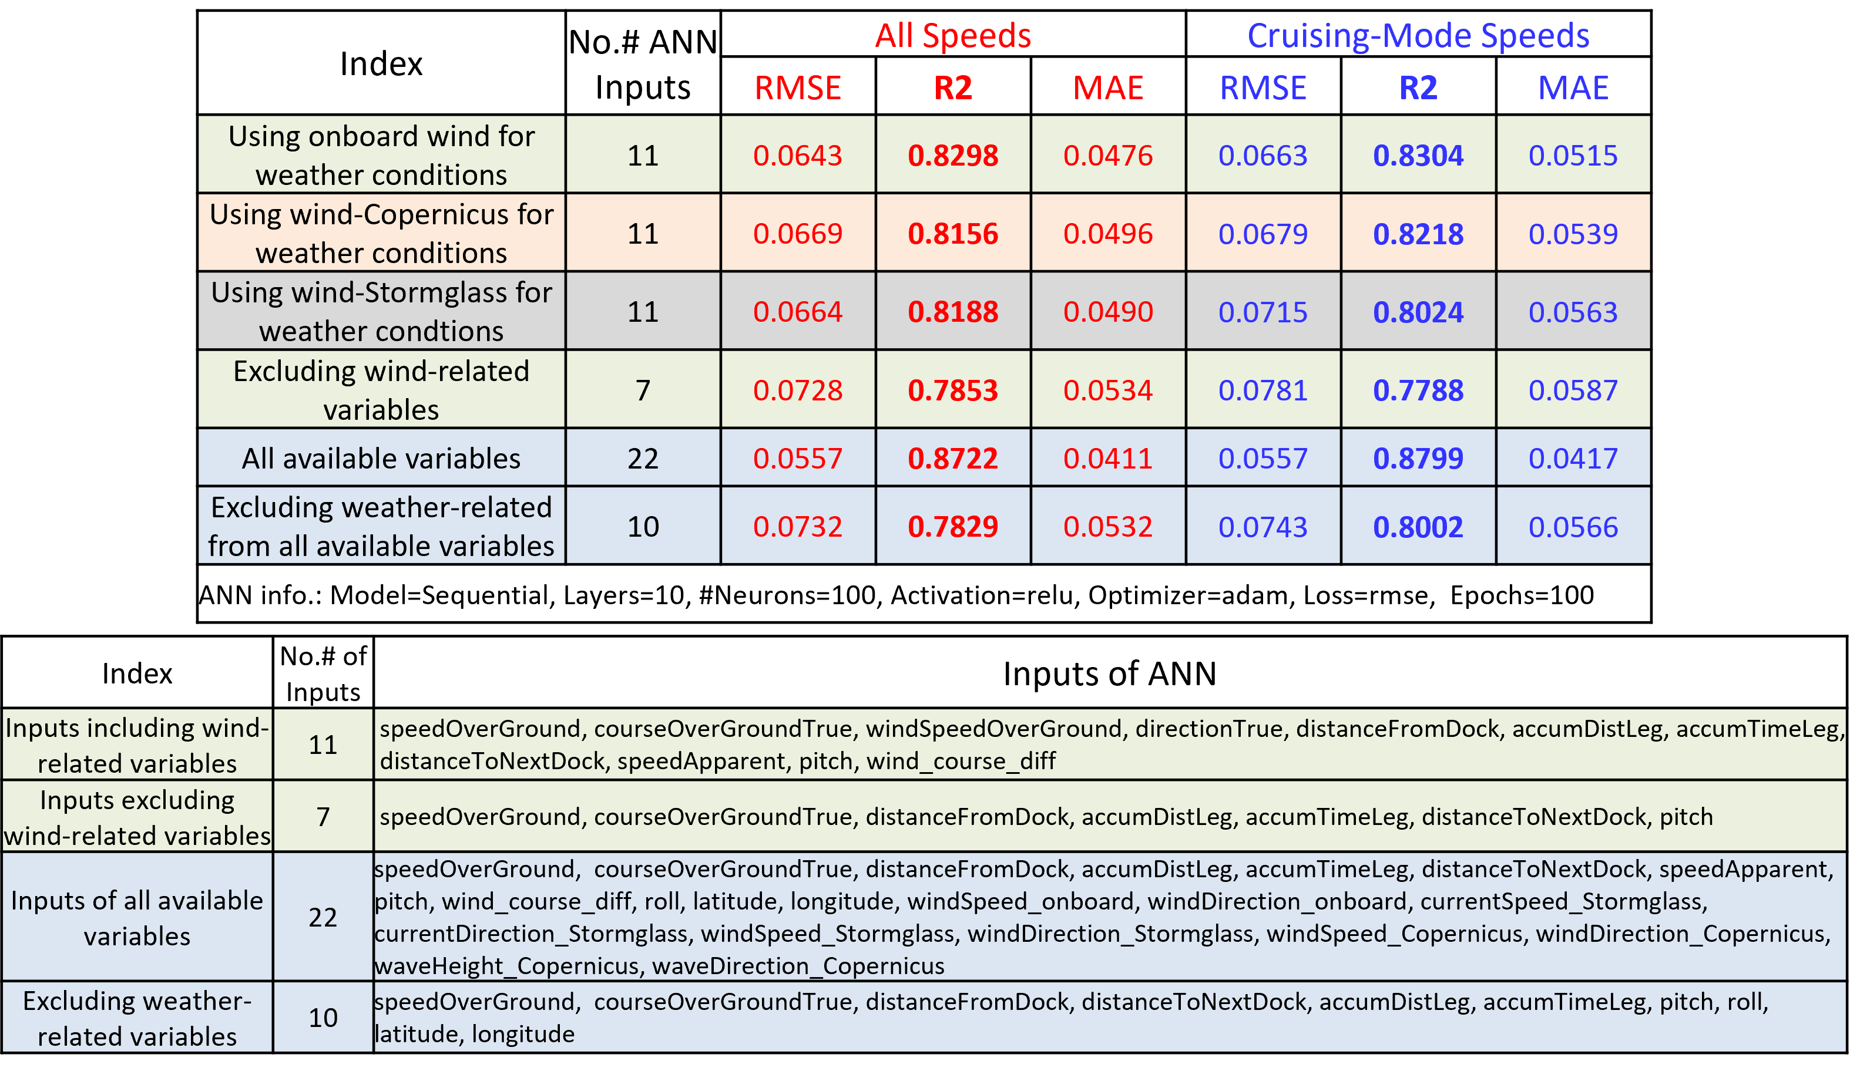
Predictive Analytics
Results of ANN regression, where fuel-rate is the ANN output, and ANN input with different cases, for both cruising-mode speeds and all speeds

Slide 25
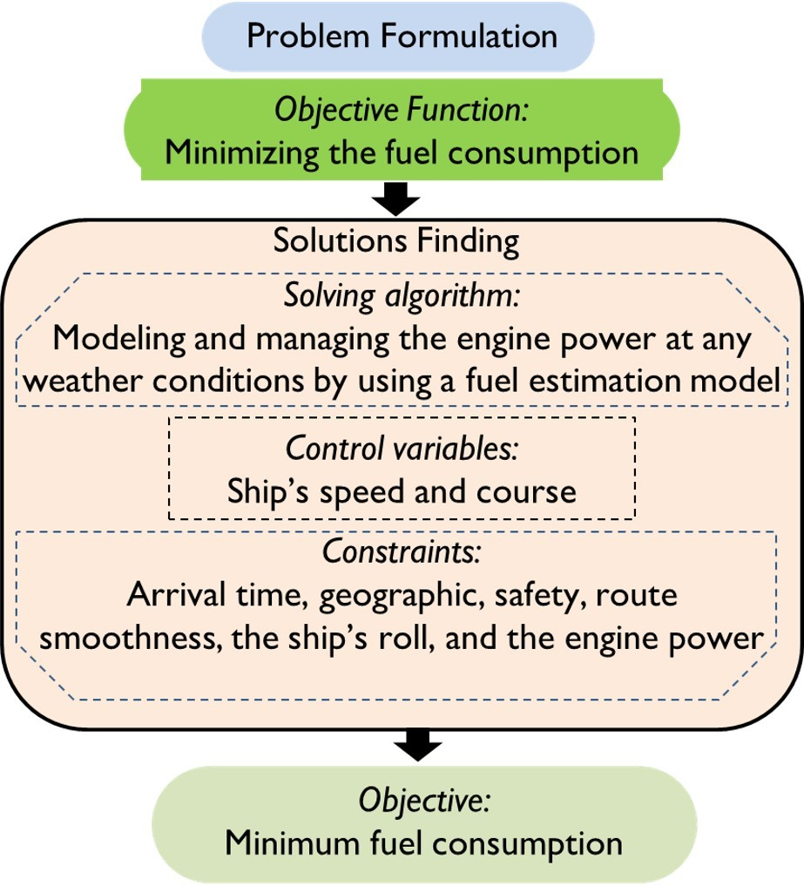
Prescriptive Analytics
Minimization of the Vessel’s Fuel Consumption
[11] Zis, T. P., Psaraftis, H. N., & Ding, L. (2020). Ship weather routing: A taxonomy and survey. Ocean Engineering
[12] Fan, A., Yang, J., Yang, L., Wu, D., & Vladimir, N. (2022). A review of ship fuel consumption models, Ocean Engineering,
[13] Wang, K., Wang, J., Huang, L., Yuan, Y., Wu, G., Xing, H.,& Jiang, X. (2022). A comprehensive review on the prediction of ship energy consumption and pollution gas emissions. Ocean Engineering.
[14] Moradi, M. H., Brutsche, M., Wenig, M., Wagner, U., & Koch, T. (2022). Marine route optimization using reinforcement learning approach to reduce fuel consumption and consequently minimize CO2 emissions. Ocean Engineering.

Slide 26
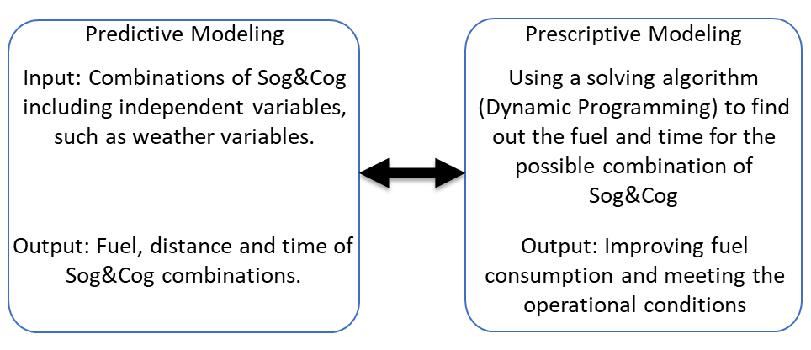
Prescriptive Analytics
Minimization of the Vessel’s Fuel Consumption
Control Variables➔Vessel’s SpeedOverGround (Sog), and Vessels Course direction (Cog).
Sog & Cog are changed from the initial case (i.e., measured onboard data). The perturbation are up, down, fixed states for each of Sog and Cog, and within the specified operational limits.
The Sog&Cog are changed simultaneously. So, there are 3²=9 combinations of possible Sog&Cog scinarios. When scenarios Sog&Cog are developed, their fuel consumption and time duration are calculated by using the predictive models of fuel and time. Thus, some of these Sog&Cog scenarios might be better than the initial case in terms of fuel and time.
Initial Case
Workflow for the Sog&Cog combinations for improving fuel consumption
The possible motion outcomes of
vessel’s Sog&Cog combinations

Slide 27
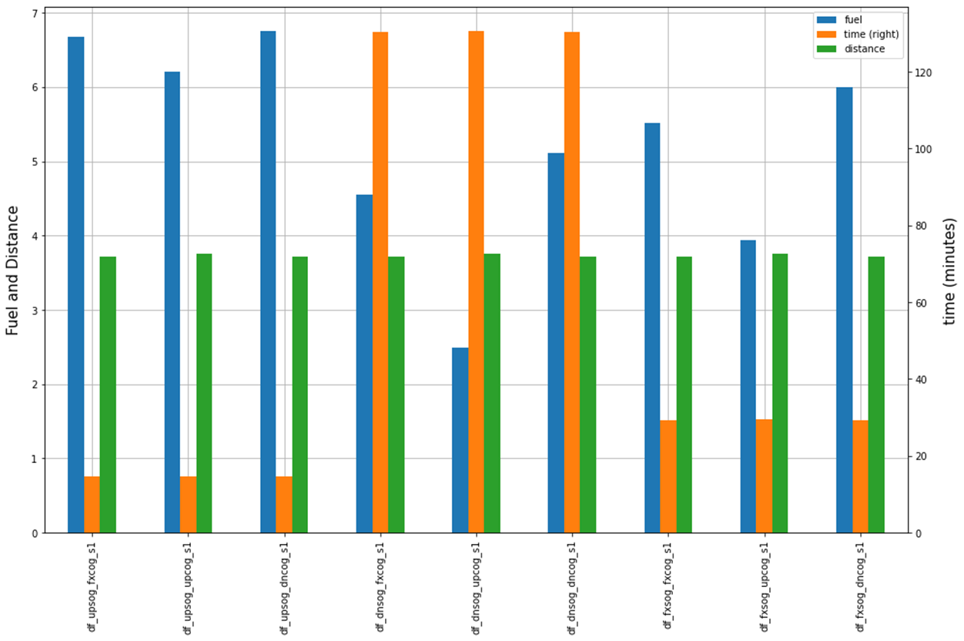
Prescriptive Analytics
Minimization of the Vessel’s Fuel Consumption
Dynamic Programming
Searching for the Best Combination of speedOverGround and CourseOverGround for Every Step on the Route
Time_i = distance/speed
If (Time_i = Time_fx_i)
Adjust Sog_i & Cog_i, Repeat
Fuel consumption
Time Constraint
If (Time > ETA)
Fuel, time and distance histograms of 9 scenarios of combinations of (Sog&Cog)
Sog= sog_fx
Cog= cog_fx
Fuel Consumption

Slide 28
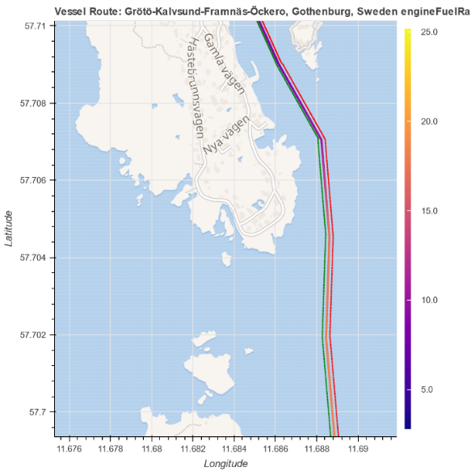
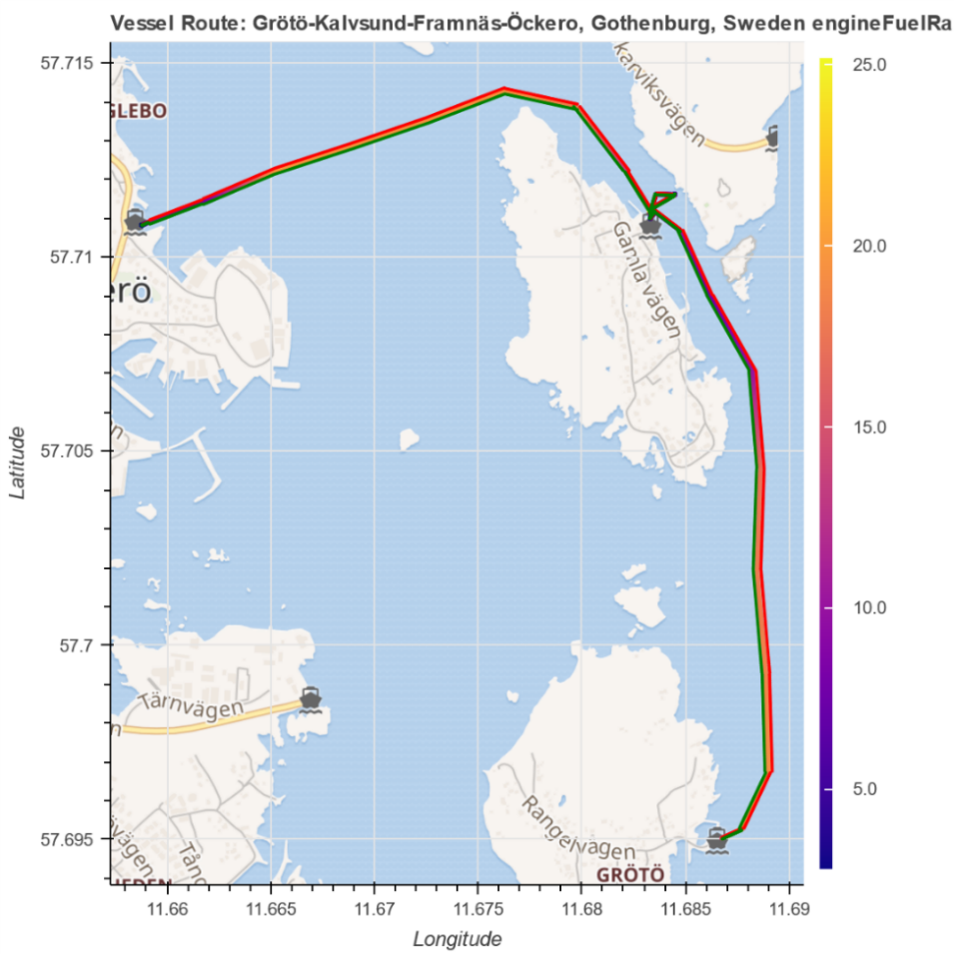
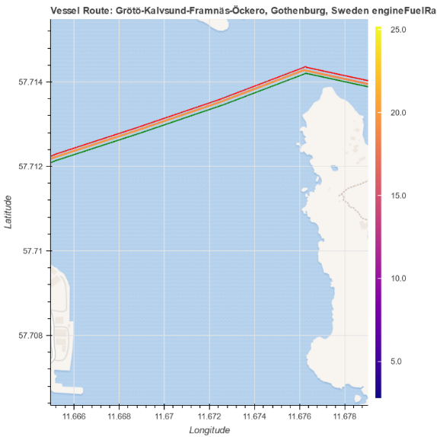
Prescriptive Analytics
Minimization of the Vessel’s Fuel Consumption
Inputs (Standard deviation)
speedOverGround (Sog) 1.814429 courseOverGroundTrue (Cog) 79.069031 windSpeedOverGround 1.886672 directionTrue 12.712350 distanceFromDock 262.871839 accumDistLeg 655.590683 accumTimeLeg 148.352875 distanceToNextDock 589.982764 speedApparent 2.967198
pitch 0.003220
wind_course_diff 80.518787
Vessel’s Route form South to North, [2020-04-05 20:38]
Fuel Rate (L/H)
Sog: Vessel’s SpeedOverGround, Cog: Vessels Course direction
Fuel Rate (L/H)
What happened if…
Changing 1 std of Sog&Cog
Changing ½ std of Sog&Cog
Changing ¼ std of Sog&Cog,
Changing 1/8 std of Sog&Cog,
Fuel Rate (L/H)

Slide 29
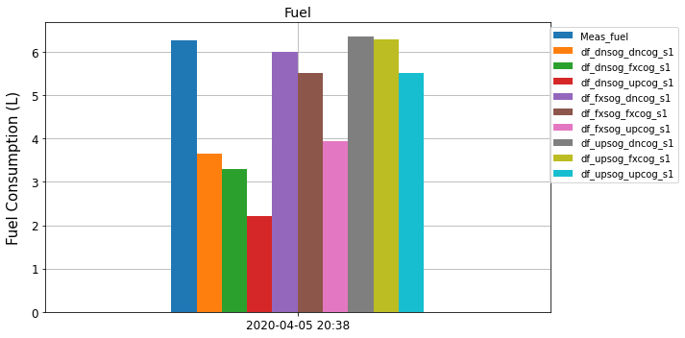
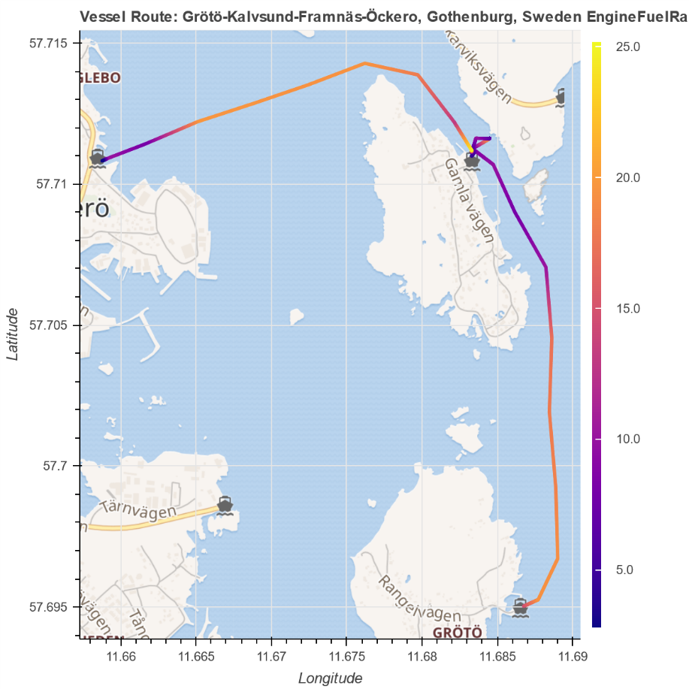

Prescriptive Analytics
Minimization of the Vessel’s Fuel Consumption
Vessel’s Rotue from South to North
[2020-04-05 20:38]
Fuel Rate (L/H)

Slide 30

Prescriptive Analytics
Minimization of the Vessel’s Fuel Consumption
Mea_rt: Fuel is measured form Onboard data.
Prd_meas_rt: Fuel is predicted by using ANN with onboard data (22 inputs).
Prd_rt: Fuel is predicted by using ANN with onboard measured data, but SOG &COG are predicted values from another ANN model.
improve of pred fuel -6.74 % improve of pred fuel 10.13 %

Slide 31


Prescriptive Analytics
Minimization of the Vessel’s Fuel Consumption
From North to South
Change=1/8 std of Sog&Cog, Route ➔ [2020-04-05 15:10]
 | Meas_rt | sel_comb | df_upsog_fxcog_s1 | df_upsog_upcog_s1 | df_upsog_dncog_s1 | df_dnsog_fxcog_s1 | df_dnsog_upcog_s1 | df_dnsog_dncog_s1 | df_fxsog_fxcog_s1 | df_fxsog_upcog_s1 | df_fxsog_dncog_s1
fuel | 6.68 | 5.59 | 6.22 | 6.19 | 3.23 | 5.97 | 5.91 | 3.00 | 6.10 | 6.05 | 3.11
time | 28.92 | 26.46 | 29.38 | 29.75 | 29.38 | 59.70 | 63.06 | 59.70 | 30.90 | 31.82 | 30.90
distance | 4.02 | 3.81 | 3.79 | 3.82 | 3.79 | 3.79 | 3.82 | 3.79 | 3.79 | 3.82 | 3.79
improve over other routes | 16.22 | 0.00 | 10.11 | 9.61 | -73.38 | 6.34 | 5.41 | -86.64 | 8.28 | 7.56 | -79.69
Sog: Vessel’s SpeedOverGround, Cog: Vessels Course direction
Counter({'df_upsog_dncog_s1': 6, 'df_upsog_upcog_s1': 2, 'df_fxsog_upcog_s1': 10, 'df_fxsog_fxcog_s1': 11})

Slide 32


Prescriptive Analytics
Minimization of the Vessel’s Fuel Consumption
From North to South
Initial Route, Route ➔ [2020-04-05 15:10],
Vessel’s Speed is shown by the color bar.
Change=1/8 std of Sog&Cog, Route ➔ [2020-04-05 15:10], Vessel’s Speed is shown by the color bar.
SpeedOverGround (m/s)
SpeedOverGround (m/s)

Slide 33


Prescriptive Analytics
Minimization of the Vessel’s Fuel Consumption
From South to North
Change=1/8 std of Sog&Cog, Route ➔ [2020-04-05 20:38]
 | Meas_rt | sel_comb | df_upsog_fxcog_s1 | df_upsog_upcog_s1 | df_upsog_dncog_s1 | df_dnsog_fxcog_s1 | df_dnsog_upcog_s1 | df_dnsog_dncog_s1 | df_fxsog_fxcog_s1 | df_fxsog_upcog_s1 | df_fxsog_dncog_s1
fuel | 6.27 | 4.11 | 4.57 | 4.61 | 2.97 | 4.55 | 4.57 | 2.93 | 4.55 | 4.59 | 2.95
time | 23.54 | 23.41 | 22.98 | 23.22 | 22.98 | 30.08 | 30.32 | 30.08 | 24.11 | 24.37 | 24.11
distance | 3.87 | 3.78 | 3.71 | 3.78 | 3.71 | 3.71 | 3.78 | 3.71 | 3.71 | 3.78 | 3.71
improve over other routes | 34.33 | 0.00 | 9.93 | 10.67 | -38.49 | 9.47 | 9.97 | -40.37 | 9.66 | 10.28 | -39.66
Sog: Vessel’s SpeedOverGround, Cog: Vessels Course direction
Counter({'df_upsog_dncog_s1': 8, 'df_upsog_upcog_s1': 4, 'df_fxsog_upcog_s1': 5, 'df_fxsog_fxcog_s1': 11, 'df_upsog_fxcog_s1': 2})

Slide 34


Prescriptive Analytics
Minimization of the Vessel’s Fuel Consumption
From South to North
Initial Route, Route ➔ [2020-04-05 20:38],
Vessel’s Speed is shown by the color bar.
Change=1/8 std of Sog&Cog, Route ➔ [2020-04-05 20:38], Vessel’s Speed is shown by the color bar.
SpeedOverGround (m/s)
SpeedOverGround (m/s)

Slide 35

Prescriptive Analytics
Minimization of the Vessel’s Fuel Consumption
Vessel’s Route from South to North [2020-2-13 21:38]
Illustration of a selected route with its boundary region
SpeedOverGround (m/s)

Slide 36
Prescriptive Analytics
Minimization of the Vessel’s Fuel Consumption
Statistics of a selected route
 | meas_rt | sel_comb | df_upsog_fxcog_s1 | df_upsog_upcog_s1 | df_upsog_dncog_s1 | df_dnsog_fxcog_s1 | df_dnsog_upcog_s1 | df_dnsog_dncog_s1 | df_fxsog_fxcog_s1 | df_fxsog_upcog_s1 | df_fxsog_dncog_s1
fuel | 4.5639 | 2.2264 | 2.4341 | 2.4789 | 2.3028 | 2.2713 | 2.3101 | 2.1441 | 2.3556 | 2.3975 | 2.2263
time | 18.5998 | 15.5468 | 23.7333 | 23.6300 | 23.7333 | 18.5383 | 27.7897 | 18.5383 | 22.2609 | 21.6821 | 22.2609
distance | 3.7622 | 3.5055 | 3.6441 | 3.7062 | 3.6441 | 3.6441 | 3.7062 | 3.6441 | 3.6441 | 3.7062 | 3.6441
Time_ExPorts | 21.0000 | 21.0000 | 21.0000 | 21.0000 | 21.0000 | 21.0000 | 21.0000 | 21.0000 | 21.0000 | 21.0000 | 21.0000
sel_comb_count | 0.0000 | 0.0000 | 0.0000 | 2.0000 | 3.0000 | 0.0000 | 1.0000 | 0.0000 | 24.0000 | 3.0000 | 0.0000
Meas_rt: Routes’ statistics when Fuel is measured form Onboard data.
Prd_meas_rt: Routes’ statistics when Fuel and distance are predicted by using ANN with onboard measured data (22 inputs).
Prd_rt: Routes’ statistics when Fuel and distance is predicted by using ANN with onboard measured data, but SOG & COG are predicted values from another ANN model.

Slide 37
Prescriptive Analytics
Minimization of the Vessel’s Fuel Consumption
Total Statistics of Sensitivity Analysis of (Sog & Cog) for Routes from North to South
RT_id | start_time | end_time | fuel_sel | fuel_meas | fuel_fx | time_sel | time_meas | time_fx | distance_sel | distance_meas | distance_fx | improve_sel | improve_meas | improve_fx
143 | 2020-02-19 22:11:00 | 2020-02-19 22:34:00 | 2.3657 | 3.0178 | 2.6672 | 18.8317 | 21.0381 | 23.9200 | 3.3211 | 3.7192 | 3.5356 | 0.0000 | 21.6078 | 11.3054
31 | 2020-01-22 05:06:00 | 2020-01-22 05:31:00 | 3.7696 | 3.7181 | 5.2756 | 17.0355 | 18.6093 | 21.2551 | 3.3442 | 3.7049 | 3.5059 | 0.0000 | -1.3875 | 28.5459
123 | 2020-02-16 21:11:00 | 2020-02-16 21:35:00 | 2.8343 | 3.4675 | 3.3617 | 16.1820 | 19.9938 | 19.5353 | 3.2890 | 3.7120 | 3.5328 | 0.0000 | 18.2598 | 15.6890
184 | 2020-05-29 22:11:00 | 2020-05-29 22:33:00 | 4.1333 | 4.2796 | 4.8425 | 14.2427 | 17.4424 | 16.4177 | 3.2139 | 3.6781 | 3.4451 | 0.0000 | 3.4191 | 14.6460
212 | 2020-06-10 08:11:00 | 2020-06-10 08:34:00 | 5.4400 | 4.3844 | 6.4316 | 16.2690 | 18.3556 | 19.2042 | 3.2772 | 3.6732 | 3.4662 | 0.0000 | -24.0747 | 15.4186
14 | 2020-01-19 07:08:00 | 2020-01-19 07:29:00 | 3.1671 | 3.1904 | 3.8309 | 16.2468 | 20.7106 | 21.3537 | 3.3763 | 3.7549 | 3.5260 | 0.0000 | 0.7287 | 17.3271
: | : | : | : | : | : | : | : | : | : | : | : | : | : | :
10 | 2020-01-17 15:11:00 | 2020-01-17 15:37:00 | 7.8794 | 10.3812 | 9.0079 | 15.4895 | 18.9403 | 24.1521 | 3.4404 | 3.8067 | 3.6956 | 0.0000 | 24.1001 | 12.5289
117 | 2020-02-16 12:41:00 | 2020-02-16 13:06:00 | 6.8629 | 9.7184 | 7.7958 | 15.2729 | 21.0180 | 18.8517 | 3.3380 | 3.8699 | 3.5816 | 0.0000 | 29.3826 | 11.9675
57 | 2020-01-27 08:11:00 | 2020-01-27 08:37:00 | 5.7046 | 9.8132 | 6.7773 | 18.1873 | 22.0188 | 21.4736 | 3.4116 | 3.9110 | 3.7027 | 0.0000 | 41.8683 | 15.8275
116 | 2020-02-16 09:41:00 | 2020-02-16 10:06:00 | 5.3939 | 10.2446 | 5.7864 | 16.4409 | 20.3245 | 19.0468 | 3.3327 | 3.7562 | 3.4854 | 0.0000 | 47.3494 | 6.7840
56 | 2020-01-27 07:06:00 | 2020-01-27 07:34:00 | 7.4641 | 9.4711 | 8.4850 | 17.7502 | 23.9923 | 25.1409 | 3.4652 | 4.0089 | 3.7662 | 0.0000 | 21.1912 | 12.0327
148 | 2020-02-20 21:10:00 | 2020-02-20 21:39:00 | 6.5094 | 9.3528 | 7.1502 | 21.5869 | 28.2192 | 26.2300 | 3.6063 | 4.0546 | 3.8491 | 0.0000 | 30.4013 | 8.9614
 |  |  |  |  |  |  |  |  |  |  |  |  | 16.12 % | 13.75 %
Total Statistics of Sensitivity Analysis of (Sog & Cog) for Routes from South to North
RT_id | start_time | end_time | fuel_sel | fuel_meas | fuel_fx | time_sel | time_meas | time_fx | distance_sel | distance_meas | distance_fx | improve_sel | improve_meas | improve_fx
234 | 2020-06-10 05:35:00 | 2020-06-10 06:05:00 | 2.7955 | 4.1054 | 3.1979 | 17.2024 | 19.4429 | 21.3220 | 3.4763 | 3.7439 | 3.6763 | 0.0000 | 31.9062 | 12.5823
151 | 2020-02-16 21:37:00 | 2020-02-16 22:10:00 | 1.5846 | 3.3537 | 1.8222 | 19.8252 | 22.5507 | 24.1039 | 3.5088 | 3.7625 | 3.7302 | 0.0000 | 52.7497 | 13.0381
71 | 2020-01-27 05:36:00 | 2020-01-27 06:06:00 | 3.0560 | 4.2572 | 3.7147 | 16.7147 | 19.9605 | 20.7067 | 3.4509 | 3.7429 | 3.6382 | 0.0000 | 28.2158 | 17.7334
79 | 2020-01-28 05:36:00 | 2020-01-28 06:05:00 | 1.5589 | 4.2842 | 1.8038 | 16.7806 | 18.9221 | 27.4204 | 3.4901 | 3.7030 | 3.5871 | 0.0000 | 63.6114 | 13.5759
167 | 2020-02-19 22:36:00 | 2020-02-19 23:09:00 | 2.9528 | 3.4310 | 3.4602 | 21.5017 | 22.4353 | 22.4004 | 3.7140 | 3.7145 | 3.6695 | 0.0000 | 13.9391 | 14.6654
65 | 2020-01-25 23:38:00 | 2020-01-26 00:08:00 | 2.5304 | 4.4599 | 2.6914 | 17.1776 | 20.5034 | 19.1324 | 3.3215 | 3.7312 | 3.4824 | 0.0000 | 43.2633 | 5.9805
: | : | : | : | : | : | : | : | : | : | : | : | : | : | :
17 | 2020-01-18 20:38:00 | 2020-01-18 21:11:00 | 6.1411 | 10.4796 | 7.0235 | 16.9058 | 22.9298 | 23.5898 | 3.4892 | 4.0932 | 3.9056 | 0.0000 | 41.4001 | 12.5634
36 | 2020-01-21 16:38:00 | 2020-01-21 17:11:00 | 8.1226 | 10.9472 | 8.6461 | 16.1319 | 22.3516 | 26.1851 | 3.6631 | 4.0934 | 3.9259 | 0.0000 | 25.8020 | 6.0544
43 | 2020-01-22 13:38:00 | 2020-01-22 14:11:00 | 7.8802 | 11.0638 | 9.1681 | 16.9732 | 19.7541 | 33.4771 | 3.6957 | 3.8975 | 3.8403 | 0.0000 | 28.7753 | 14.0482
118 | 2020-02-06 11:39:00 | 2020-02-06 12:06:00 | 6.7428 | 11.3370 | 7.8373 | 15.1999 | 21.6332 | 29.3259 | 3.3967 | 3.9552 | 3.7397 | 0.0000 | 40.5242 | 13.9663
44 | 2020-01-22 15:38:00 | 2020-01-22 16:11:00 | 7.8820 | 11.4362 | 8.7765 | 17.2251 | 21.7469 | 22.1487 | 3.5578 | 4.0984 | 3.8958 | 0.0000 | 31.0784 | 10.1918
41 | 2020-01-22 06:35:00 | 2020-01-22 07:05:00 | 11.0770 | 11.7608 | 12.8244 | 18.6095 | 22.7132 | 35.1997 | 3.8947 | 4.3538 | 3.9740 | 0.0000 | 5.8142 | 13.6259
 |  |  |  |  |  |  |  |  |  |  |  |  | 31.31% | 12.28 %
_meas : Routes’ statistics when Fuel is measured form Onboard data.
_fx : Routes’ statistics when Fuel and distance are predicted by using ANN with onboard measured data (22 inputs).
_sel : Routes’ statistics when Fuel and distance is predicted by using ANN with onboard measured data, but SOG & COG are predicted values from another ANN model.

Slide 38
Thanks for your listening Any Qs? Mohamed Abuella mohamed.abuella@hh.se Center for Applied Intelligent Systems Research (CAISR) Halmstad Univesity 2022
Notes:
I’ll briefly talk about different CAISR+ subprojects.

